Slide 1

Game Reporting
USA Hockey has implemented a game reporting system available on USAHockey.com
Require game reports for:
All Major penalties
All Match Penalties
All Game Misconducts
All Major penalties are required to be reported!
Rule change 2021, Rule 403: All Major penalties require an additional game misconduct!

Slide 2
At the end of the game
Make sure the scoresheet is correct
Penalties correctly entered, period, time
Rosters correctly entered, players, coaches
Ineligible players crossed off
Game location and time are correct
Make any administrative changes
You cannot CHANGE a penalty
File supplementary game report
Sign the game scoresheet…legibly

Slide 3
Before you leave the rink
COLLECT IMPORTANT GAME INFORMATION
Collect White copy of Game Score sheet
Game Time, Date, & Location
Teams involved
Level of Play (classification / age)
Player(s) numbers and names
Coach’s name
Time of incident
Penalties assessed
USAH Officiating Numbers and names of partners

Slide 4
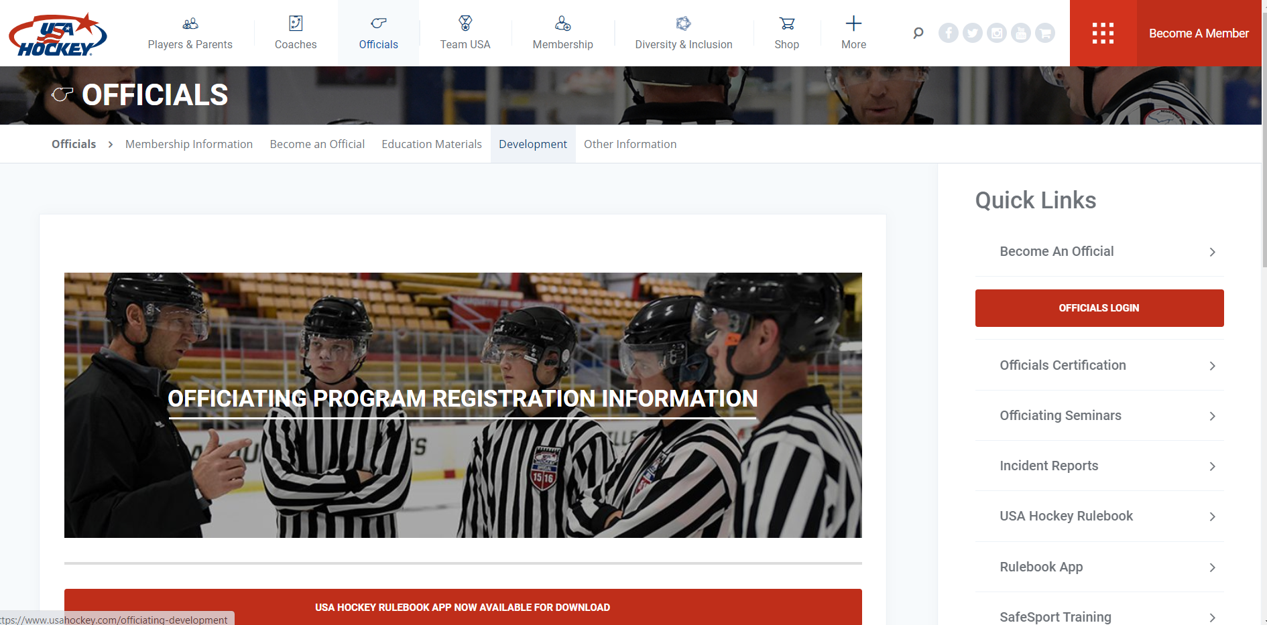
USAHockey.com
Click on ‘Officials’ and then ‘Incident Reports’

Slide 5
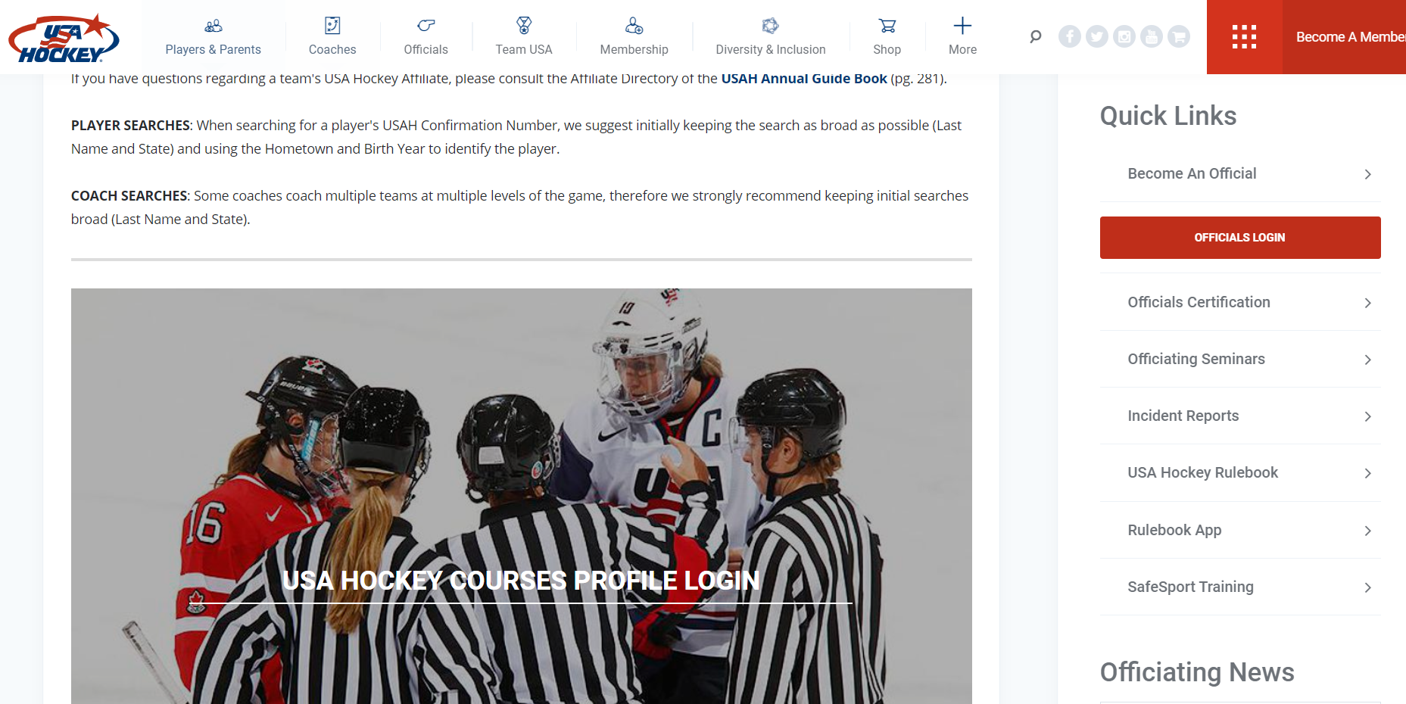
Log into your profile

Slide 6
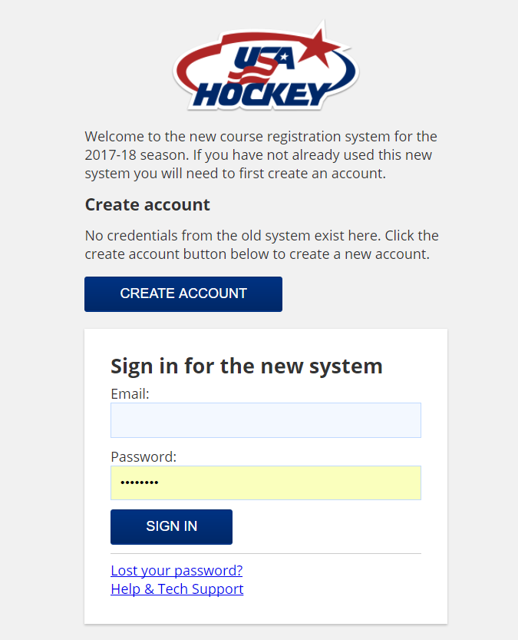
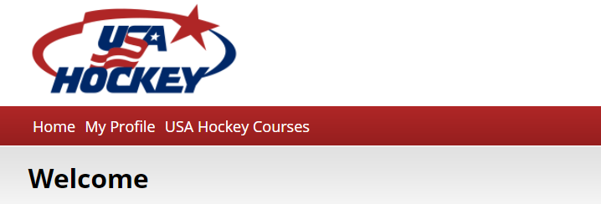
Log into your Profile
Sign in……
‘Then click ‘MyProfile’

Slide 7
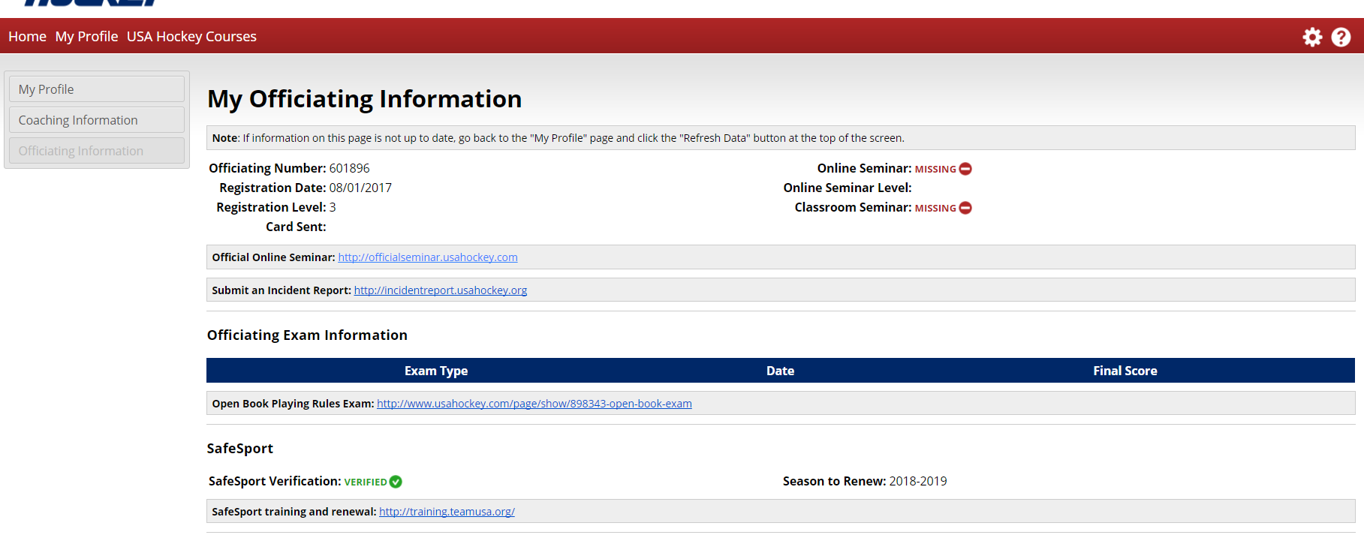
Once you are logged in…
Once you have signed in, click on:
‘My Profile, then click on
‘Officiating Information’
Submit the Incident Report here:

Slide 8
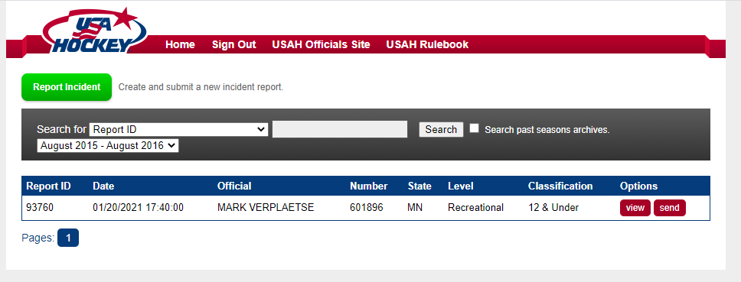
Welcome to the system…
Click the
GREEN BUTTON
to begin

Slide 9
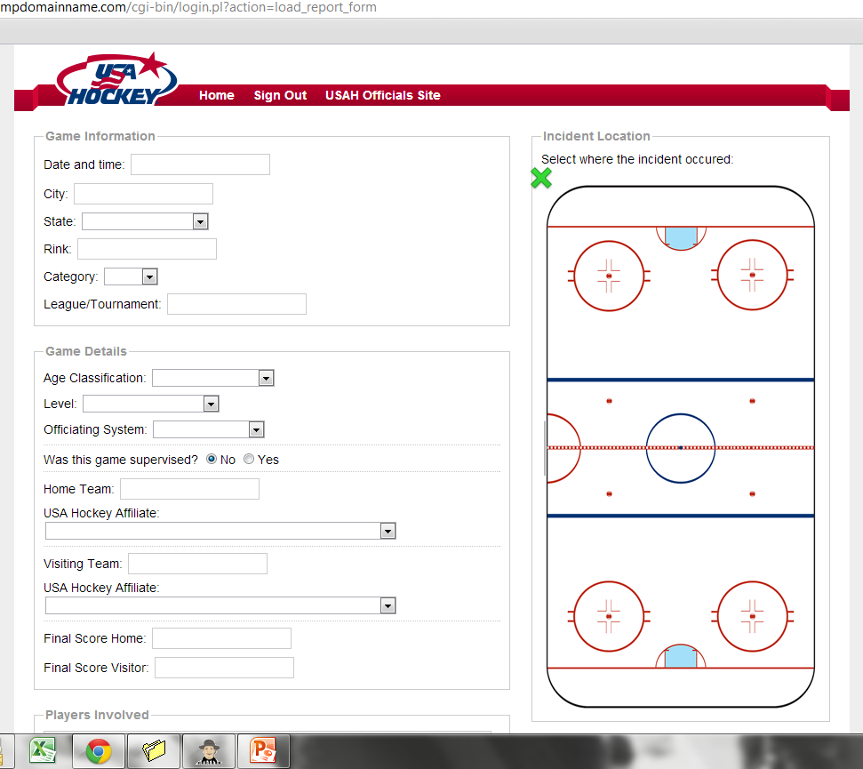
Begin filling in the data fields…

Slide 10
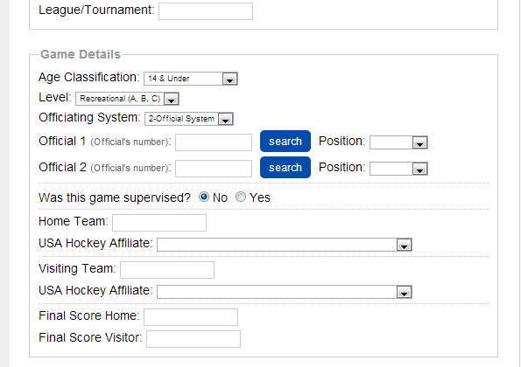
Officiating System…
When you click on ‘Officiating System’, you will be asked to fill in the officials working the game. Use your USA Hockey registration number here! Your information will be filled in automatically.
OR, push ‘Search’ and enter in the official name and state. You will be able to select the official here.

Slide 11
Home/Visitor Teams
Enter the Home Team Name and Visitor Team Name Exactly as it appears on the score sheet!
Enter the affiliate of this team.

Slide 12
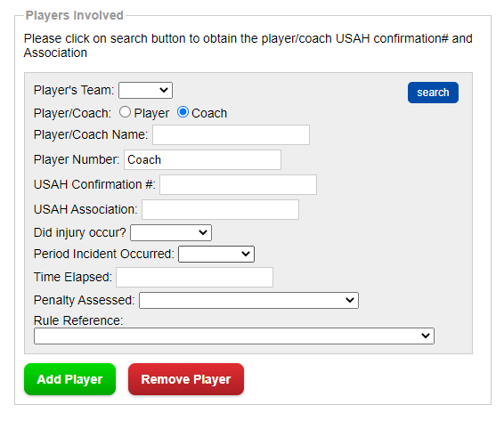
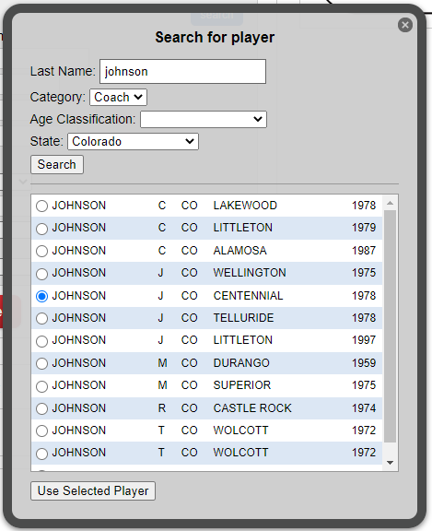
Search for Player or Coach
Select the player/coach and click on ‘Use Selected Player’

Slide 13
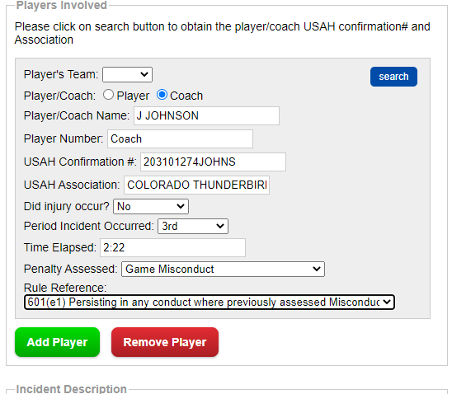
Player or Coach involved
Player/coach information is filled in for you.
Enter an injury occurred as a result of this incident.
For youth games, use the ‘clock’ time of the incident.
Enter the penalty assessed and the rule reference. Be sure to indicate the correct rule!
If more than one player involved add that player here.

Slide 14
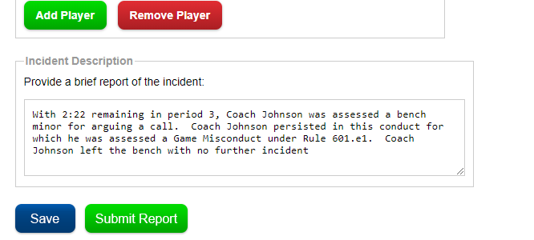
Brief Report of Incident – This is your opportunity to describe what happened.
Without getting over-specific, what lead to the infraction?
What happened that caused you to assess the penalty?
Factual information is critical, opinions are not.
Click ‘Save’
Come back later and
Click ‘Submit Report’

