Slide 1


Addressing the Funding Gap in
Mandated Categorical Programs

Slide 2

Setting the Stage
Evidence-based funding has been a state priority and has been transformative towards achieving equity in school funding
Proration of MCATs is continuing to decline due to increased costs and state funding that is not keeping pace
Need to educate stakeholders on the whole picture of school funding in IL
Budget priorities for FY27 are starting to take shape

Slide 3
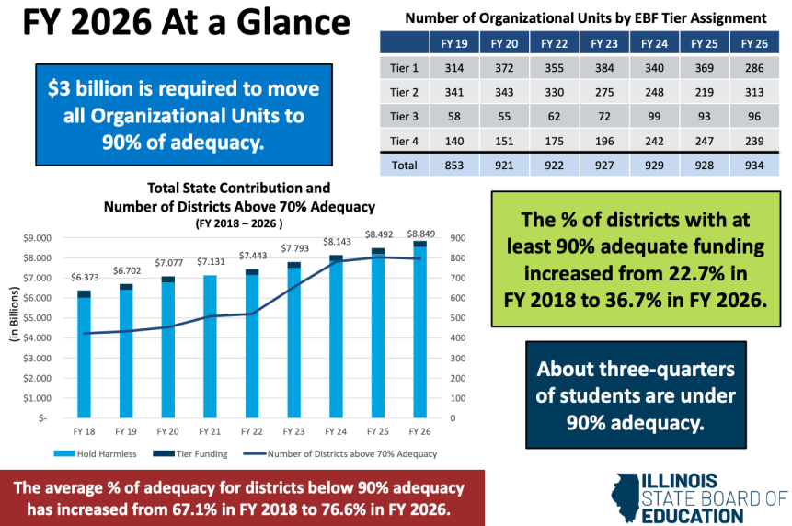

Slide 4
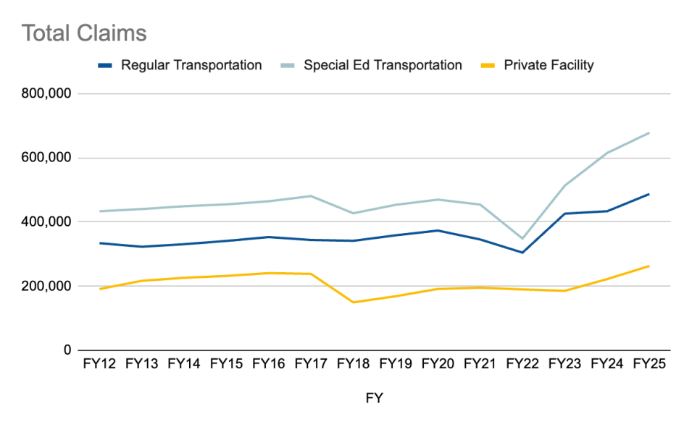

Slide 5
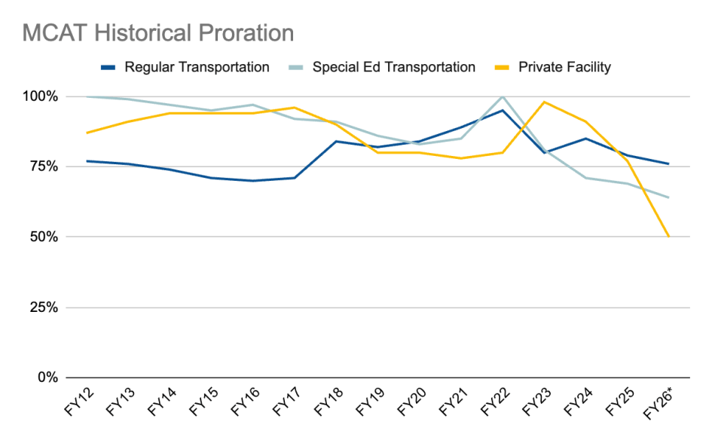

Slide 6
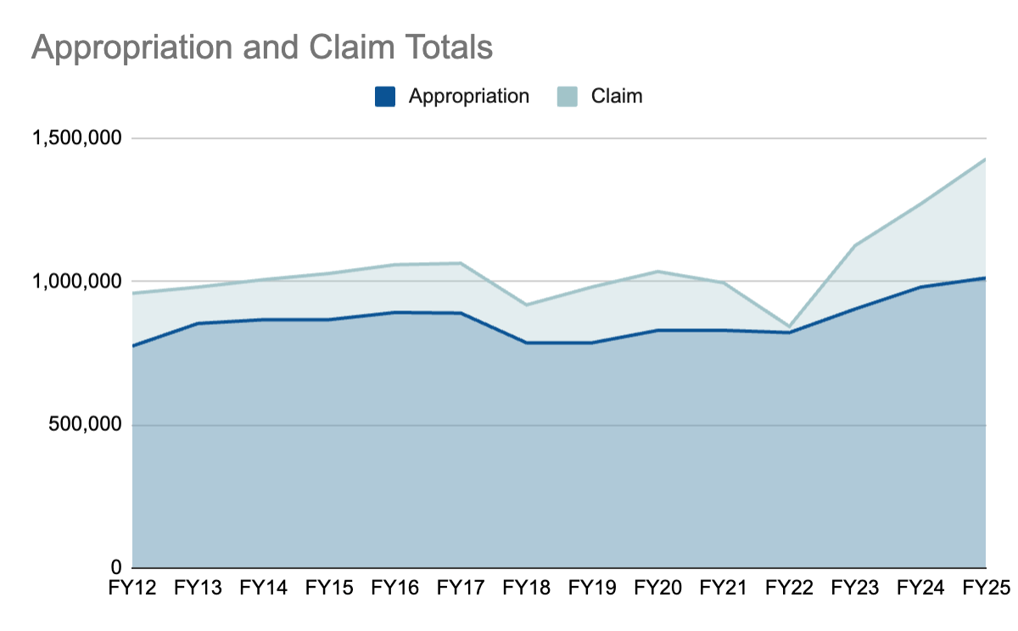

Slide 7
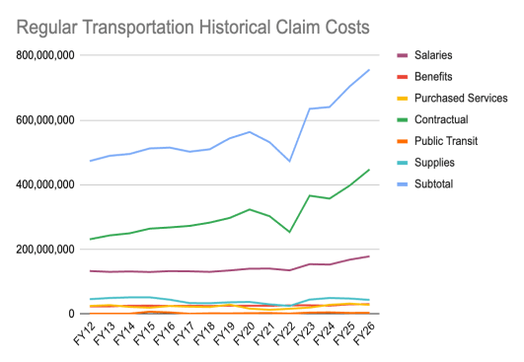
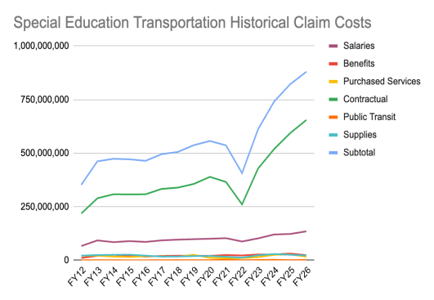

Slide 8

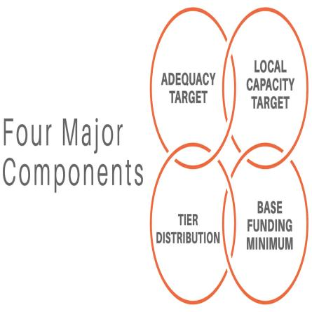
EBF 101

Slide 9
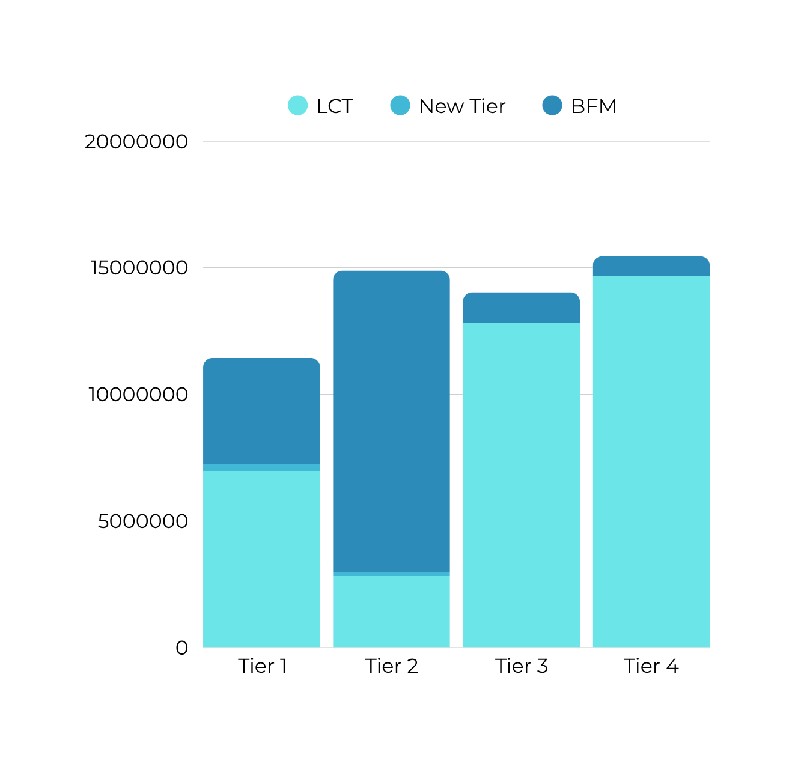
Local Impact: Funding Scenarios

Slide 10
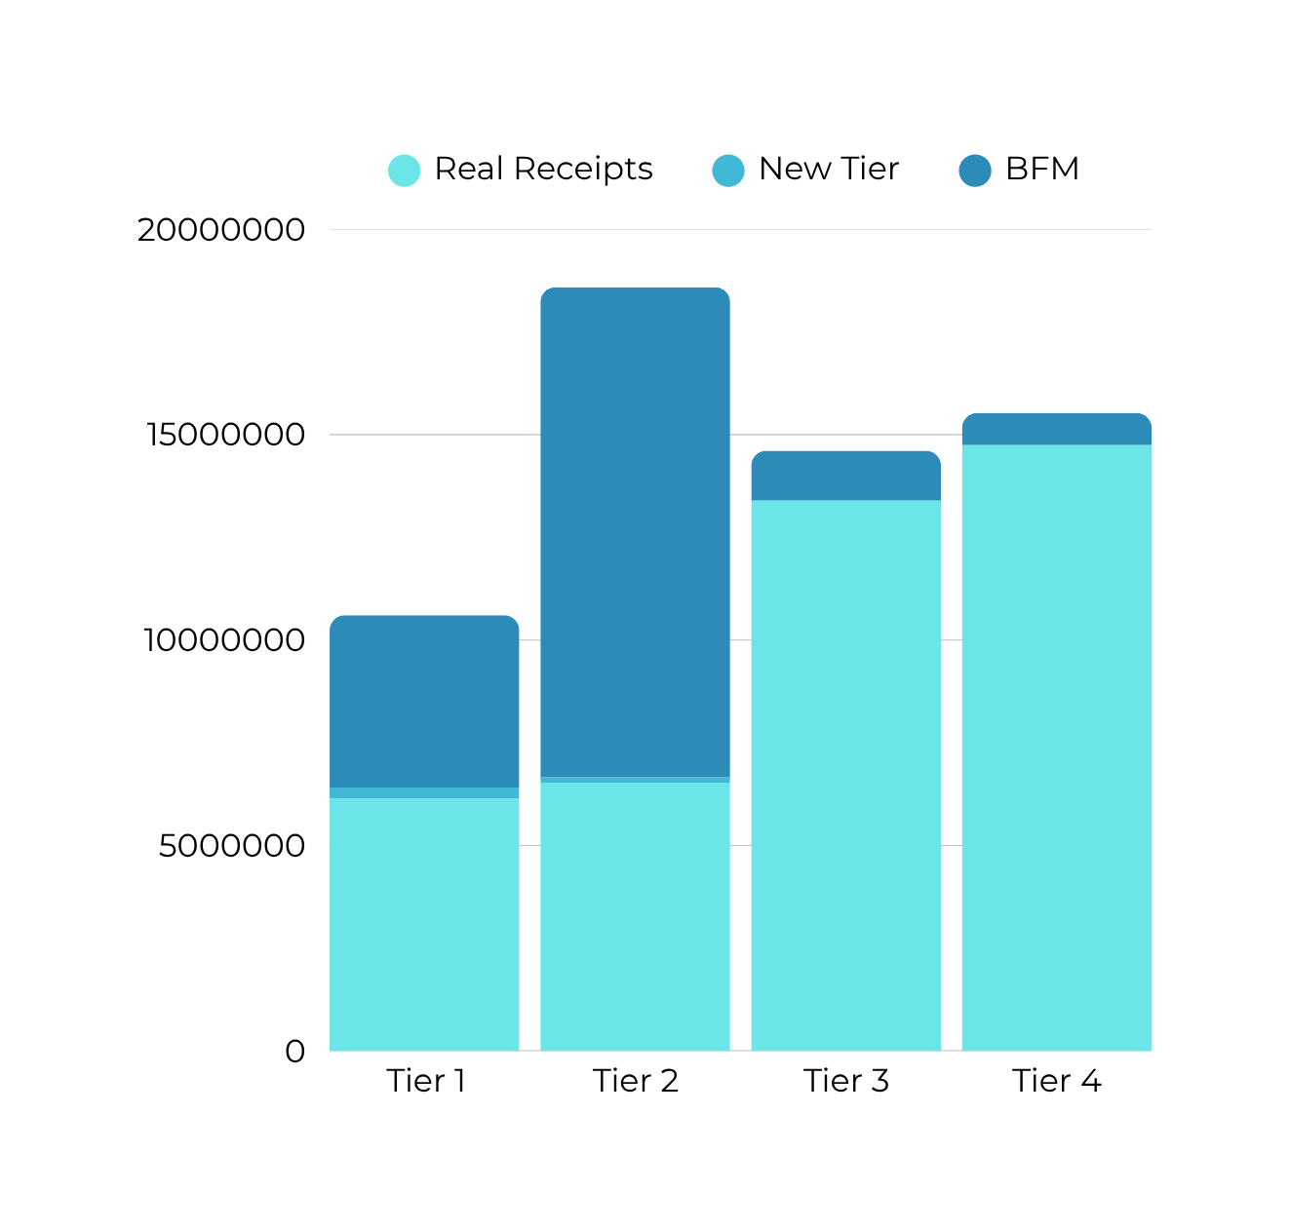
Local Impact: Funding Scenarios

Slide 11
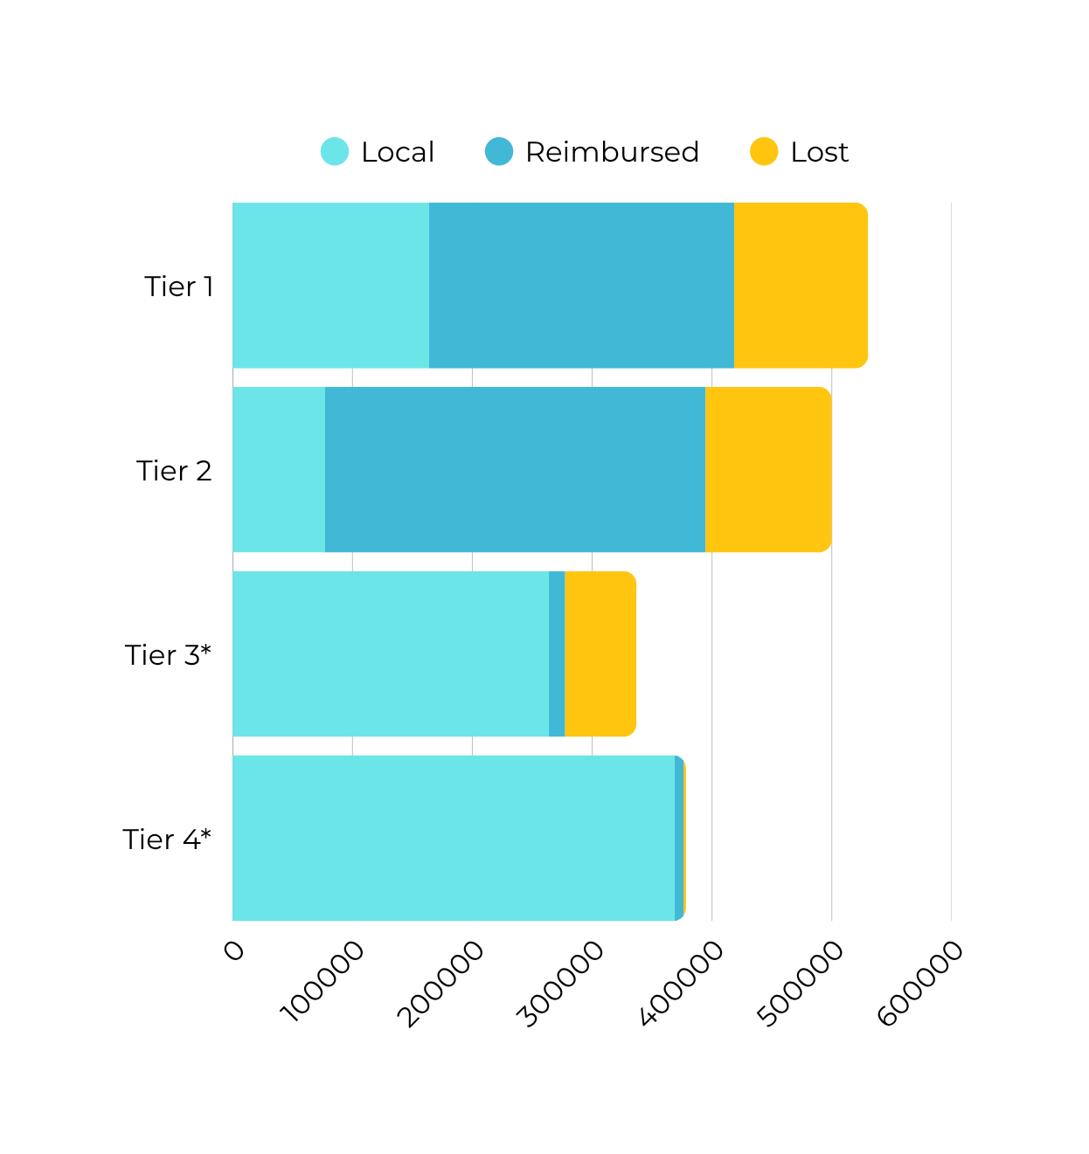
Local Impact: Regular Transport

Slide 12
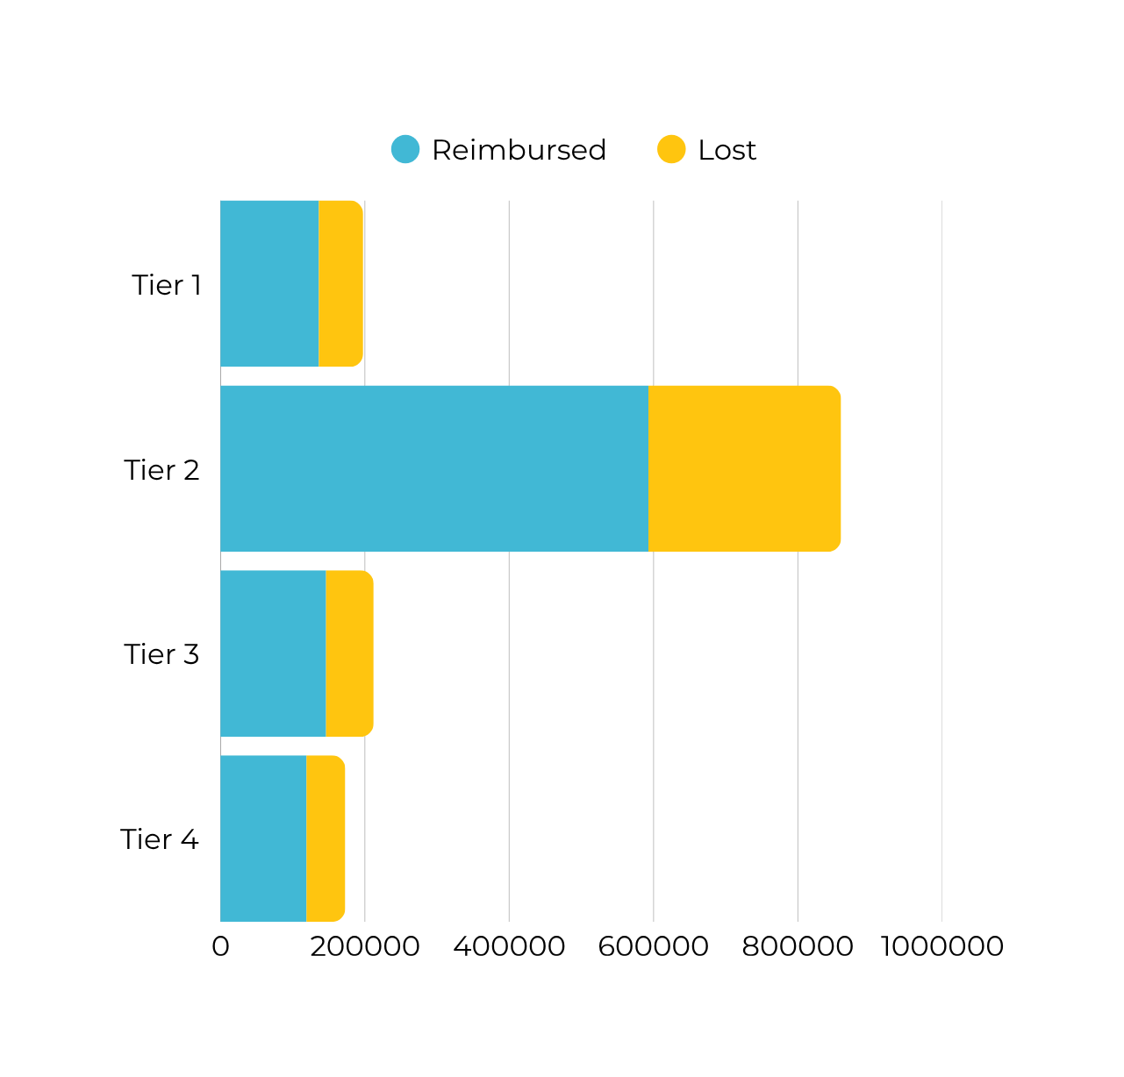
Local Impact: Spec Ed Transport

Slide 13
Talking to Your Legislators
Important Talking Points
Always start with appreciation!
Keep the focus on students and outcomes, not finances alone
Avoid framing EBF as “backfill” - describe the pressure underfunded mandates create
Emphasize that one (or both) pay the price of underfunding - students or taxpayers

Slide 14
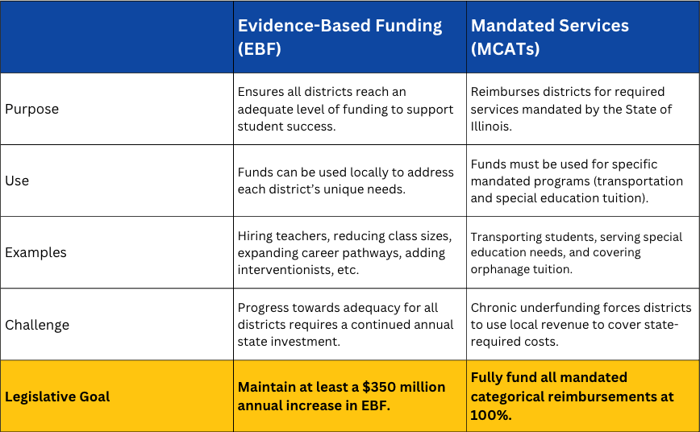
Talking to Your Legislators
Our Ask: “Fully fund mandated categorical programs alongside continued investment in EBF.”

Slide 15
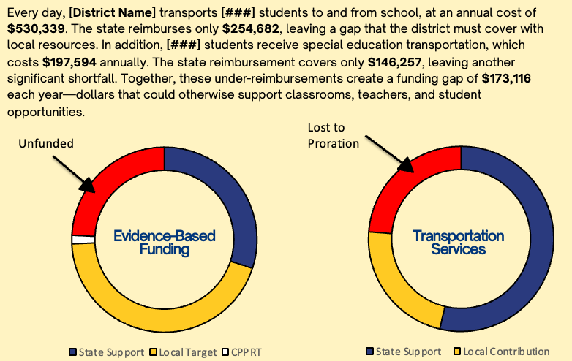
Talking to Your Legislators
One-Pager Template

Slide 16
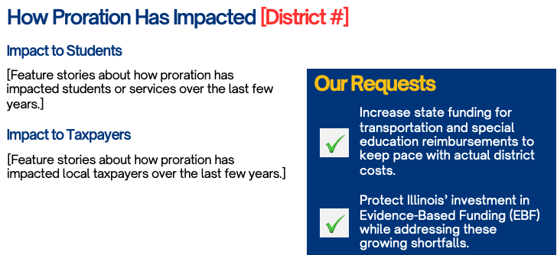
Talking to Your Legislators
One-Pager Template

Slide 17
Talking to Your Legislators
Issue Framing
These funding streams don’t compete -
they complete each other!
We can’t solve for adequacy by destabilizing funding for mandates, and we can’t solve mandate funding by stalling progress towards adequacy.

Slide 18
Next Steps
Complete the one-pager using your district’s data
Contact your legislators to set up a meeting (individual, county, region, etc)
Share feedback you receive from your legislators
Stay alert for communication from IASA on updated advocacy tools, talking points, and Action Alerts

Slide 19



Thank You!
“Together, we can ensure
IL continues to invest in
both access and
opportunity –
funding the
full education puzzle for
every student!”
217-501-5551
ewarnecke@iasaedu.org
www.iasa.edu

