Slide 1
Running Development
Will Harrison
CSCS, USA TRACK AND FIELD Level 2, Lydiard Running Level 2, USTFCCCA CERTIFIED

Slide 2
Today we will discuss:
Running form - How should I run?
Pre-run warm-up/drills
Footwear- overview of traditional running shoes and developing trends
Overview of different training intensities and periodization
Strength and supplemental work-Staying injury free

Slide 3
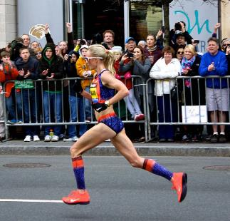
Running form- How should I run?
1. Cadence of approx. 180 steps/minute
2. Foot lands “under” body
3. Need for hip extension
  Leg = pendulum
4. Slight forward lean
5. Elbows back
6. Individual skeletal alignment should be accounted for
Gait should be hip dominant!

Slide 4
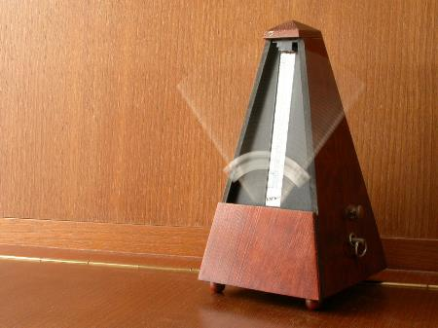
Cadence
Cadence: number of steps taken per minute
Often the best place to start when doing form analysis; will help other pieces fall into place
Most people over stride and need to take shorter, quicker steps
180 steps/minute is often touted as the ideal running cadence
  https://www.google.com/search?q=metronome&rlz=1C1GGRV_enUS752US752&oq=metronome&aqs=chrome..69i57j0l2j69i59j0l2.3810j0j7&sourceid=chrome&ie=UTF-8

Slide 5
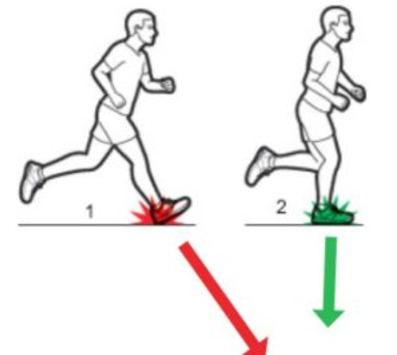
Cadence
Increasing cadence, and thereby shorter quicker steps; helps the foot land under your center of mass. This increases efficiency and decreases the forces your joints must withstand on each step.
Note: faster cadence does NOT mean faster pace.

Slide 6
Cadence
Note: faster cadence does NOT mean faster pace.
How to improve cadence with your client:
Observe them running on treadmill at their moderate running speed.
Quietly use a metronome to determine their current cadence
Aim to adjust by 5 to 10 percent at a time
Notes:
Will likely feel harder to run the same speed with a faster cadence at first; over time will increase efficiency and feel more natural. Best to hone in on at beginning of training cycle.

Slide 7
Hip dominant running form
Glutes are a fatigue-resistant muscle group useful for endurance activity
Many runners benefit from glute activation exercises pre-run…i.e.
glute bridges, multi-direction lunges… or even doing their run immediately after their strength training

Slide 8
Hip dominant running form
Again, hip dominant running form will help prevent overstriding and increase efficiency;
Ability to tap into glute muscles= less stride in front; more in back; foot lands under center of mass instead of way out in front
Essential for posture
Hip flexilbility may need to be addressed to in order to reach optimal hip extension

Slide 9
Drills to help achieve this
Shopping cart drill
Elbow jab drill
Banded foot drag

Slide 10
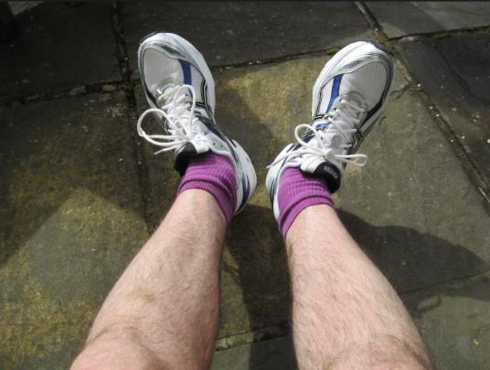
Respect your anatomy
Do toes have to be straight ahead?
Some runners will feel best with their toes pointed straight ahead, some feel more comfortable with toes pointed out. Do whichever allows your knees to track straight ahead.

Slide 11
Form
“I am running healthy without any injury issues- should I consider changing my running form?”
A few non-negotiables:
  Enough motion to get your leg behind your body (pendulum)
  Postural Stability
  Strength and power of the glutes to propel your body upwards and forwards

Slide 12
Warm-up/Pre Run
Good for most runners to do something to activate glutes and loosen up hips pre-run:
Leg Swings - forward, lateral, bent-knee
Walking mobility drills i.e. reaching quad stretch, frankensteins, leg cradles, knee hugs)
Lunge matrix- 10 each for forward, lateral, back and to the side, reverse, reverse lunge w/twist

Slide 13
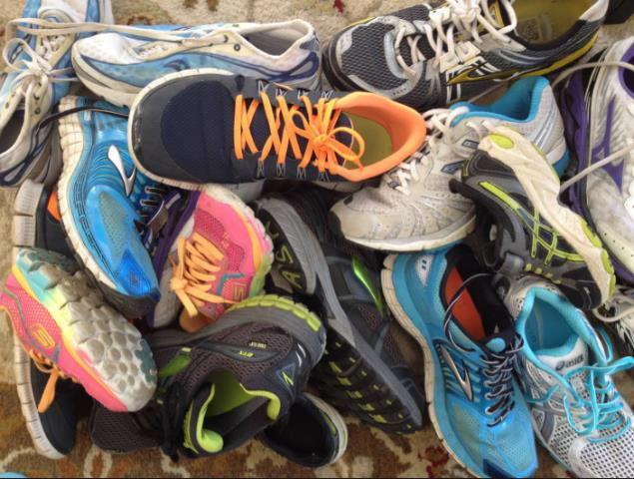
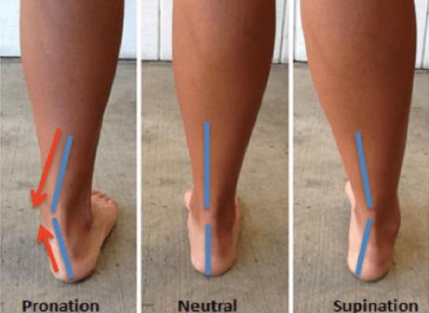
Proper Footwear
Still a lot we don’t know about optimal shoes
Shoe industry generally classifies 3 types of runners:
Pronaters ( majority of us) , neutral, supinaters

Slide 14
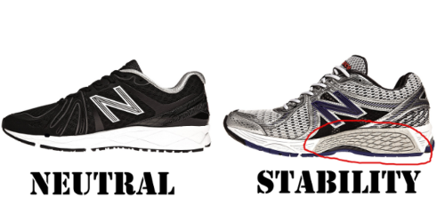
Shoes
Historically, overpronators have been placed in shoes with more of a medial post (“stability” shoe) and/or orthotic device to reduce pronation, while neutral runners have been placed in shoes without this (“neutral” shoes)
However, this is a very hot and somewhat divisive topic in the running world at the moment

Slide 15
4 Basic Components of Traditional Running Shoes and why they are being re-examined
Posting- material on the medial side of the shoe that tries to limit pronation
Cushioned materials-softer surfaces to absorb impact
High heels- heel is about 2x higher off the ground than the forefoot
Narrow Toe box-supposedly for improved fit
Let’s explore why these are being re-examined

Slide 16
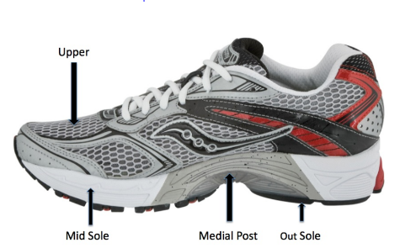
Components of traditional running shoes
Medial Posting
Argument Against:
Though designed to keep the foot from moving in too much, maximum pronation actually occurs after the heel has left the ground; meaning that the posting isn’t even in contact with the ground at the time it is theoretically most needed.
Allows contact point between foot and ground to drift too far towards the inside of the foot, increasing stress on the inside of the knee

Slide 17
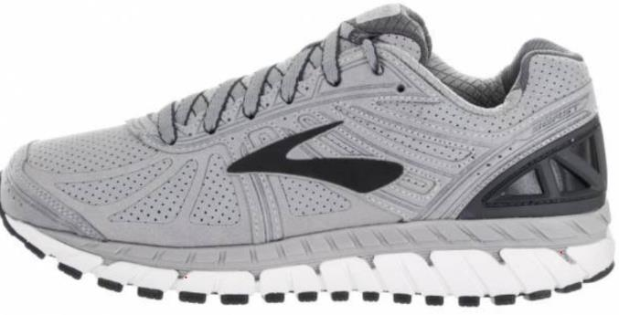
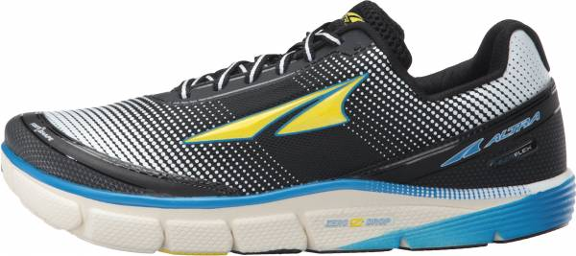
Components of Traditional Running Shoes
High Heels: Most traditional running shoes have a heel that is about 10 to 12mm higher than the forefoot
12mm heel-toe differential vs 0mm heel-toe differential

Slide 18
Components of Traditional Running Shoes: High Heels
But why? No one has shown that a flat footed position is a bad position to be in, and some studies show that elevated heel may compromise foot proprioception and throw off normal muscle firing patterns
Feels more natural to land w/ foot more underneath you, instead of out in front, with a smaller heel/toe offset
Even if you aren’t running in flat shoes, it’s a good idea to spend some time in them during the day
More” zero drop” shoes coming out; also some major shoe lines are gradually reducing the heel/toe offset as new models come out

Slide 19
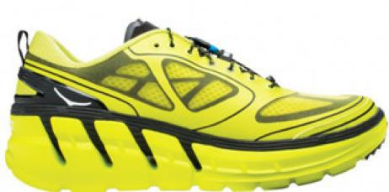
Components of Traditional Running Shoes
Cushioned materials
Softer and more cushioned not always better- there is a point of diminishing returns where more filter between your foot and the ground = less feedback to your feet, and less muscle activity/control
However, runners with high, rigid arches do often do better in a softer/more cushioned shoe.

Slide 20

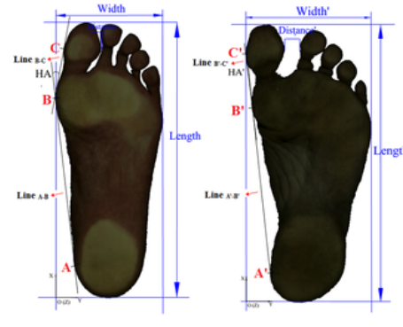
Components of Traditional Running Shoes
Narrow Toe Box
A newborn’s foot- widest part is the TOES
But, fashion has led to shoes that taper in the front- almost like we have been practicing Chinese foot binding, hence our toes have been squeezed together by wearing shoes all day
From Foot Morphological Differences Between Habitually Shod and Unshod Runners:

Slide 21
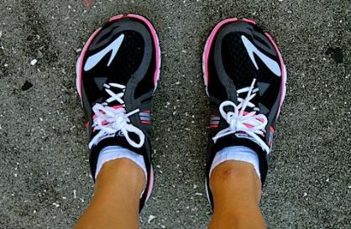
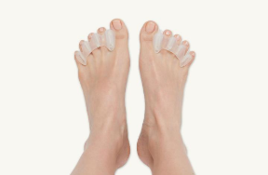
Components of Traditional Running Shoes
Narrow Toe box
New trend:
A wider foot, particularly big toe, dramatically improves leverage
More foot splay = more leverage=more control
Hence, new brands developing shoe with wider toebox (altra, topo, vibram, viviobarefoot)
Correct Toes Tool:
Using shoes with a wider toe box may cause your feet to expand and go up a shoe size

Slide 22
So what shoes should you wear?
Stick with your current shoe if: your shoes are working for you and you have no pain, no reason to make a change (even if wearing an 8 to 12 mm drop)

Slide 23
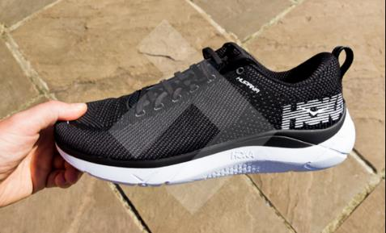
So what shoes should you wear
Consider adjusting to 3 to 8mm heel/toe drop if: want to improve muscle activity, balance, proprioception, foot strength running economy-drop current offset by no more than half (i.e. no more than 6mm), and do half your volume in this shoe for 2 to 4 weeks

Slide 24
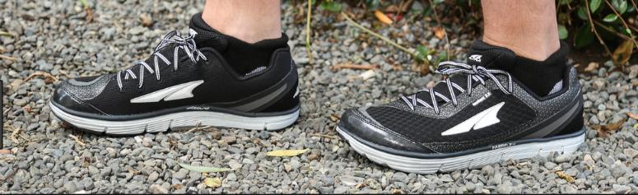
So what shoes should you wear?
Consider zero drop shoe if : you want all the benefits above, less lever arm on the joint at all cost- highly effective in runners with arthritis and joint degeneration, compartment syndrome, runners needing to decrease loading rates. Very gradual transition- wear the shoes walking around for 2-4 days; initial run is ½ mi, increase volume by ¼ to ½ mi each run thereafter
this type of shoe may be the future and is likely great to start off toddlers/young children in this type of shoe to develop strong, stable feet
Cost/benefit should be carefully considered for adults considering adjusting to this type of shoe

Slide 25
Running Program Design
Daniels’ Training intensities (Based on VDOT formula from recent race)
Easy (E)
Long (L)
Marathon Pace (M)
Threshold (T)
Interval (I)
Repettion (R)

Slide 26
Easy Running (E)
Pace where most runners spend a majority of their weekly run time
Opportunity to accumulate mileage needed to reach weekly mileage goal
Conversational pace that is comfortable to manage
65 to 78% of max heart rate
Still important to maintain good running mechanics

Slide 27
Long Runs (L)
Longest run of the week
Typically about 20 to 25% of weekly mileage total (may be 30% if running under 40 miles/wk)
For runners over 40 miles per week; long run should be the lesser of 25 percent of weekly mileage, or 150 minutes, whichever comes first
Keep in mind a 20 mile run is more stressful for a slower runner than a faster runner

Slide 28
Marathon Pace Running (M)
Can use VDOT tables to estimate this pace for runners who have not previous run a marathon
A single session at M pace should not exceed the lesser of 18 miles or 20 percent of your weekly mileage
Purpose:
  Adjust to the specific pace to be used in the upcoming marathon; can also help runners who are not training for a marathon build confidence that they can run faster than Easy pace for an extended period of time

Slide 29
Threshold Running (T)
Intensity is “comfortably hard”
Definitely working hard; but pace is manageable for a fairly long time (i.e. 20 to 30 minutes)
Often described as pace you can run, if peaked and rested, for 60 minutes if giving it full race effort.
Purpose:
  Improves the speed you can maintain for a relatively long period of time
  Improves the ability of your body to clear blood lactate and keep it below a manageable level

Slide 30
Threshold Running (continued)
2 main types of threshold running:
Tempo Runs (i.e. 20 to 30 minutes at T pace)
Cruise Intervals
  i.e. 6 x 5 minutes @ T pace w/ 1 minute rest in between

Slide 31
Interval Training (I)
Most physically stressful zone of training
Also referred to as VO2 Max training; also Hard (H) training
Pace you could maintain for 10 to 12 minutes of racing time
Total volume of I/H training should equal no more than 10K OR 8 percent of weekly training volume

Slide 32
Interval Training (cont’d)
Typically 3 to 5 min workbouts w/ slightly less recovery (i.e. 4 x 3 min w/ 2 min jog recovery, 5x 4 min w/ 3 min jog, or 6x2 min w/ 1 min jog)
This is the type of workouts/training it is easiest to overtrain with; and where injury is most likely to happen
*Very well-conditioned, experienced runners only! Many, if not most, runners will be better emphasizing Tempo/Rep work on workout days, 2x/wk, w/ E paced runs on other run days*
Notes:
Minimum effective dose

Slide 33
Repetition Pace Training (R)
Primary purpose is to improve anaerobic power, speed, and running economy
Entails running at a faster pace (approximately race pace for a 1mi or 3k race); usually followed with a recovery jog equal to the length of the rep
i.e. 8 x 200m @ R pace w/ 200 m jog recovery
OR
4x 400m @ R pace w/ 400m jog; 8 x 200m @ R pace w/ 200m jog
Total volume should be the lesser of 5 miles or 5% of weekly running volume

Slide 34
Developing a Season Plan
Things to ask at the start of a training cycle:
Average weekly total run volume (miles or minutes) over the past 2 months?
Any races in the past several months?
How much time do you have per day/week to devote to running?
What is available to you for running? (Trail, treadmill, etc)
What races are you planning to run in the next 6 months?
What is your most important race in the next 6 to 12 months?

Slide 35
Daniels Periodization: Where do the different intensities fit in over the course of a training cycle?
4 phases; typically 3 to 6 weeks each
Phase 1: Foundation and Injury Prevention
Primarily E running; needs to include some neuromusclular work (i.e. strides/ relaxed sprints at least 2 days/wk, 100 to 200m; strength training/supplemental work)
Notes:
Cellular benefits and minimizes chance of injury

Slide 36
Periodization
Phase 2: Early Quality Training
Incorproates approx. 2 workouts per wk of T and/or R running; other training days consist of primarily E pace runs
Introduces faster workouts into the season program
Reps should not be very taxing on the cardiovascular/aerobics system
i.e. for a 5k/10k runner 10 to 12 by 200m (or 45 sec) @ R pace w/ 200m jog(or 1:30 jog) in between and longer rest at halfway point

Slide 37
Periodization
Phase 3: Transition Quality Training
Most stressful, event-specific training
Time to optimize the components of training that apply to your goal race.
Good time for a off-distance race; can use in place of a training session
Sample for a 5k runner: 4 x 5 min @ I pace w/ 4 min rest (very well-conditioned, experienced runners only!)
Sample for marathon runner: 2 hours or 15 mi @ M pace
Notes:
Only well-conditioned, experienced runners need to go through this phase. 5k runner will spend more time at I pace; marathon runner more time at M pace

Slide 38
Periodization
Phase 4: Final Quality Training
Not as demanding as Phase 3 (less, if any, I sessions, emphasis on T running w/ some R/I work)
Set up workouts to account for race conditions (i.e. time of day, weather)
Work on strengths (addressed weaknesses earlier in training cycle); final workout/s should be type of workout athlete enjoys

Slide 39
Periodization
Another way to think of it is you are progressing workouts over the course of a training cycle to gradually decrease the rest periods so that workouts gradually more closely resemble the race
i.e. training for a 5k:
Early season workout: 24 x 200m@ 5k pace w/ 200m jog rest (an R workout)
Late season: 3 x 1 mi @ 5k pace w/ 5 min rest (an I workout)

Slide 40
Strength/Supplemental Training for Runners
People stick to plans better when they understand the “why”
Purpose of strength training for endurance athletes:
  Improve energy resistance
  Decrease energy leaks
  Improved nervous system adaptations (Able to recruit more muscle fibers)
  Improved rate or force development
  Thus leading to increased efficiency, speed, endurance

Slide 41
Strength/Supplemental Training for Runners
Strength/supplemental exercises fall into 3 categories
Produce horizontal force w/ deadlift pattern
  Front to back movements that address powerful glute muscles
Produce vertical force w/ squat pattern
  Up/down movements that incorporate muscles around knees and hips
Establish 3D postural/core control
  Ability to control/resist force through all planes of motion

Slide 42
3D Postural Control
i.e. Banded hip twists, single arm/leg shoulder press, farmer walk w/ high knee, anti-rotation squats
Notes:
Lots of ways to accomplish this

Slide 43
Strength/Supplemental Work for Runners
1. Make your muscles smarter
  Dynamic stability-runners need to stabilize the body as they move it forward
  Repetitive forces through unstable levers =disaster
  Efficient neuromuscular control helps the body more effectively transfer loads between muscle/tendon tissues and minimize internal work by the body
  Find most challenging level where athlete can be successful and build on that

Slide 44
Strength/Supplemental Work for Runners
1. Make your muscles smarter
Core control-”proximal stability before distal mobility”
  Timing, more than strength=key
  Need ability to create rapid micro-corrections (i.e. mastering a squat, 4 square hops, etc)

Slide 45
Strength/Supplemental Work for Runners
2. Make your muscles stronger
Once you have control, generating more force = running faster
Should runners focus on high weight/low rep?
  If goal is to improve muscle coordination and movement skills, then low weight/high rep is appropriate to give athlete chance to learn form
  If goal is to improve performance by rapidly activating/recruiting more muscle, heavier (but appropriate) laods make sense—should be moderately challenging but not done to failure

Slide 46
Strength/Supplemental Work
3. Get more spring in your step
Optimize the speed of energy transfer w/ Olympic lifts and/or plyometric training
Helps to maximize performance AS LONG AS forces are going through stable levers

Slide 47
References
Daniels, J. (2005) Daniels Running Formula, 2nd Edition. Champaign, IL: Human Kinetics
Daniels, J. (2014) Daniels Running Formula, 3rd Edition. Champaign, IL: Human Kinetics
Dicharry, J. (2012) Anatomy For Runners: Unlocking Your Potential for Health, Speed, and Injury Prevention. New York, NY: Skyhorse Publishing
Dicharry, J. (2017) Running Rewired: Reinvent Your Run for Strength, Stability, and Speed. Boulder, CO: VeloPress
Hudson, B. (2008) Run Faster: From the 5k to the Marathon. New York, NY: Broadway Books
Johnson, C. (2018) Running on Resistance: A guide to Strength Training for Runners to Build Injury Resilience and Improve Performance.
Magness, S. (2014). Science of Running: How to Find Your Limit and Maximize Your Performance. Origin Press

