Slide 1
The Road Ahead for Greater Hartford Area Real Estate Professionals 18 November 2016
Jim Clayton, PhD, President RERI, Weimer Fellow
Head Investment Strategy & Analytics, Barings Investment Advisors
John L. Glascock, PhD, FRICS, SIOR, ULI Global Scholar, NAR Scholar
Professor of Real Estate and Urban Studies, University of Connecticut

Slide 2
Outline
1. A little philosophy
2. Market conditions
3. A few caveats

Slide 3
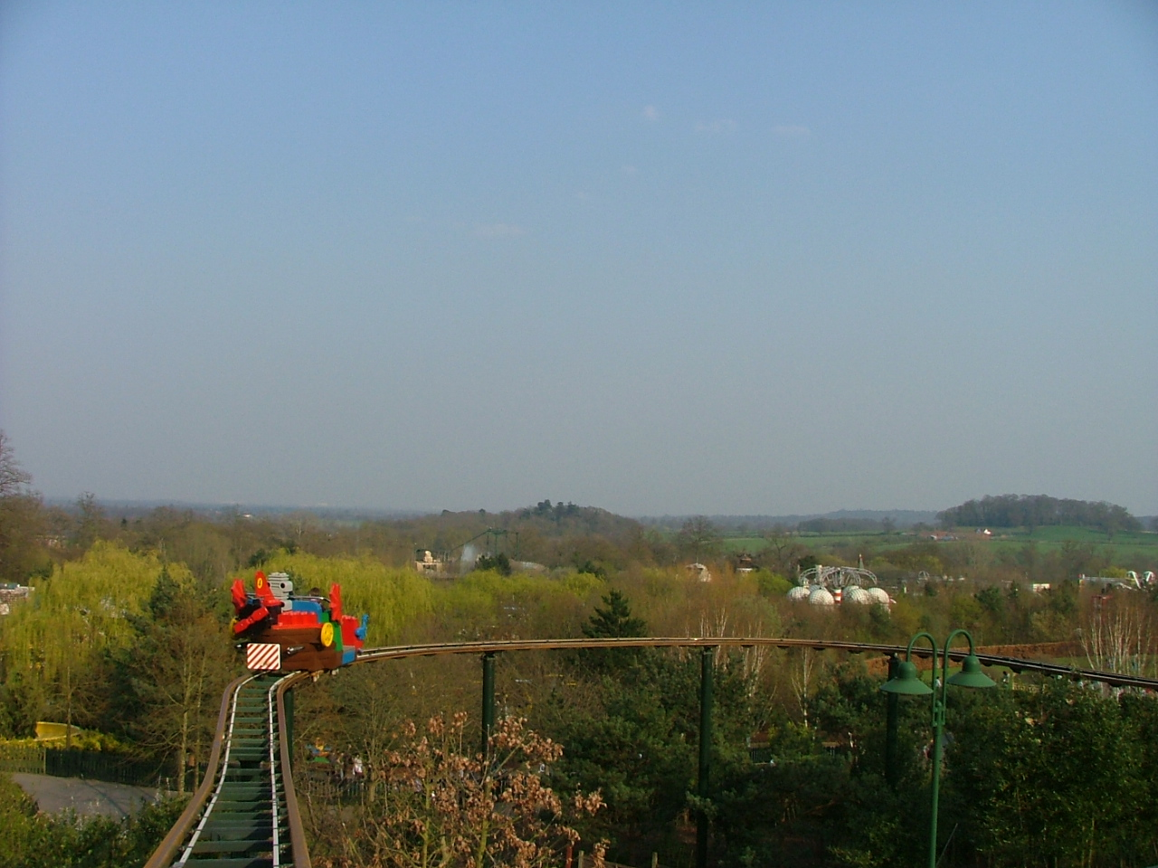
Just for fun—Decision Making: UK LegoLand Cars are numbered 1-14, what car follows No 8?

Slide 4

What car is after no. 8? Risk or Uncertainty?

Slide 5
Risk and Uncertainly
Not only did 2 follow 8
But 13 was out for repair!
In risk, one knows the probabilities: in uncertainty, one does not know the probabilities! This was uncertainty.

Slide 6
Rule 1
Know when it’s
risk
or
uncertainty
If it is risk, we can hedge
If it’s uncertainty, we must position

Slide 7
Risk versus Uncertainty
The current market is full of RISK!
Trump
CHINA
Europe Union

Slide 8
Einstein and Modelling
Albert Einstein's General Theory explained that the universe was not static! This was against religion and convention theory (by the way, his General Theory was against established theory!)
Thus, Einstein altered his work to allow for a static universe.
In 1922, Alexander Friedmann showed what Einstein dared not—the universe could be expanding. In 1927, Georges Lemaitre reached the same answer. Today, we give credit to Friedmann/Lemaitre for a most remarkable observation—the universe is expanding. ENSTEIN lost one of his more important implications of HIS Theory because he didn’t trust his model!
See Matthews, 25 Big Ideas, 2005.

Slide 9
Rule Three:
Have a good Model
and Believe it!

Slide 10
Let’s use your new – who should have won the election!
OLD rules—forever!
1. REAL Liberal do not win
2. People vote their pocketbook
NOTHING new about the outcome…

Slide 11
What is the Markets?
A QUICK View:
1. GDP about 1.5% for 2016 and 1.6 for 2017
2. Inflation 1.8 for 2016 and expect 2.5 for 2017
3. 10-year Treasury Note 2.5 by end of 2017 (conflict!)
4. Housing 5.5% for nation in 2016 6.5% for 2017
5. Retail up 3.4 for both 2016 and 2017 (excluding gasoline)
Three caveats (really bads):
1. Top 100 companies the USA control more of GDP than ever!
Co’s with 1000 or more employees control 39.5% of the economy
ATT/Time Warner—would produce 2 out of every $100 profits in the USA-listed firms!
USA pays 50% more for mobile service: USA firms get 28 cents on operating Profit: Europe 18!
Slowest internet (WIFI) of the developed countries—need competition, not monopolies!
2. China (Fallows of Atlantic Monthly—finally gets it!))
3. Europe is in Trouble (Google, Apple, Airbus, Volkswagen..)

Slide 12
Real Estate Markets
UP:
Industrial-especially associated with RETAIL
Single-family homes—even more in a few years
Need new stock-mis-match between existing houses and people
Down:
Offices—particularly in Class A large Cities (Forbes-Trump)
Apartments—particularly in non-top cities
Metro areas that are not at least regional hubs—transportation and people
More RISKY
REITs

Slide 13
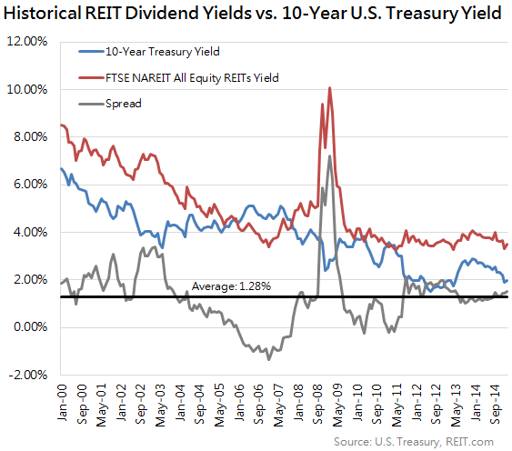
REIT Yields will likely to widen!

Slide 14
Key Urban areas
National ‘Super’ cities
New York City
Los Angeles (more diversified than NYC
Chicago—but perhaps declining!
Washington DC—but artificially so
Miami (Brazil is NO 1 trading partner
Regional ‘Super’ Cities becoming National (?)
Atlanta (double the growth rate of Boston last 5 years
Boston (housing costs are an issue-limited diversity
Dallas
Seattle
Denver
Raleigh (hired more Engineers last 5 years than Boston!
{Phoenix ? Note}

Slide 15
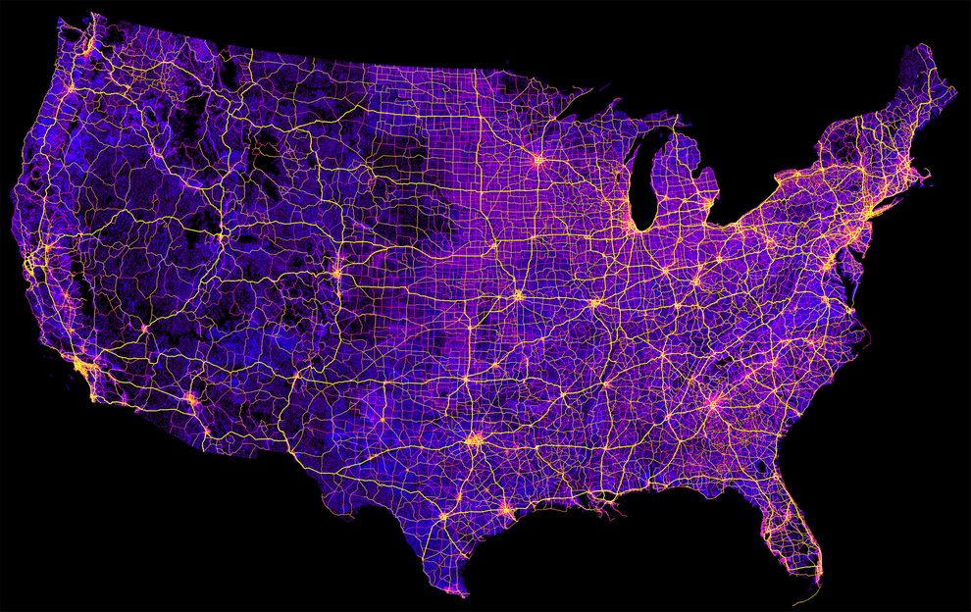
Roads and America—tell you a lot!

Slide 16
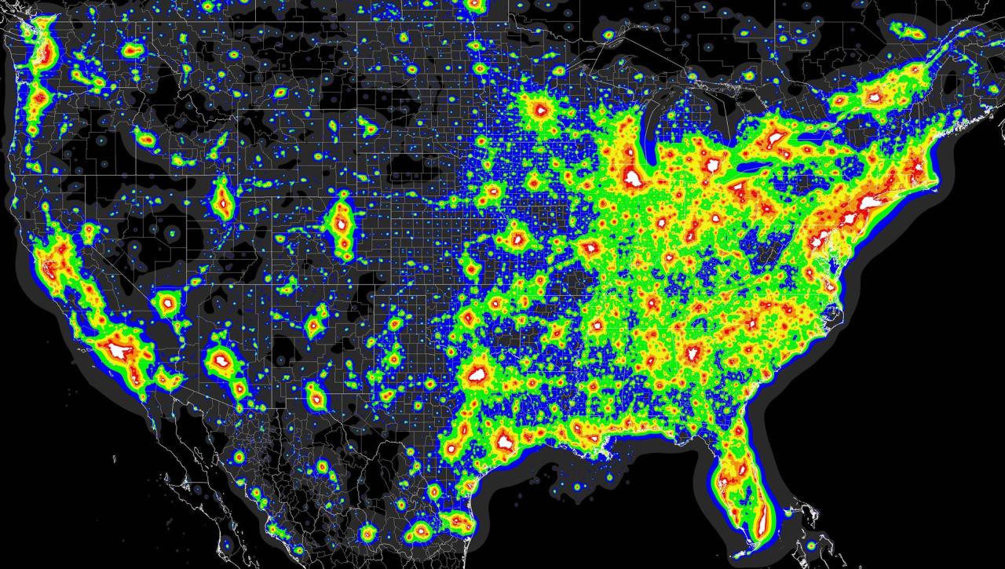
USA light intensity-urban areas

Slide 17
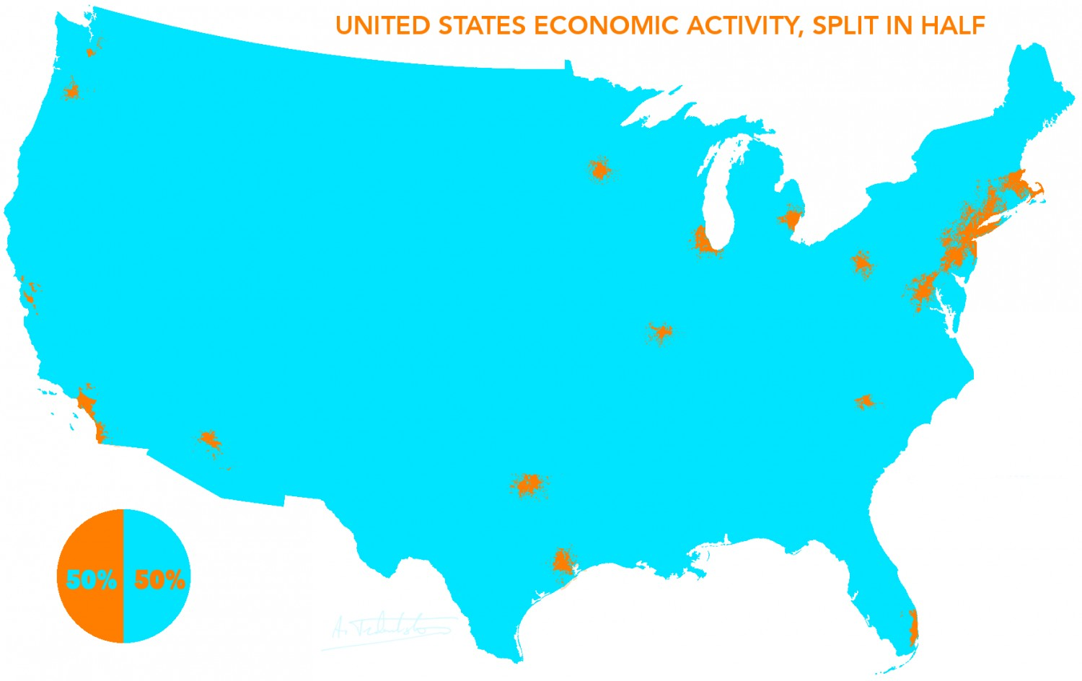
One-half of all Economic Activity in GOLD!

Slide 18
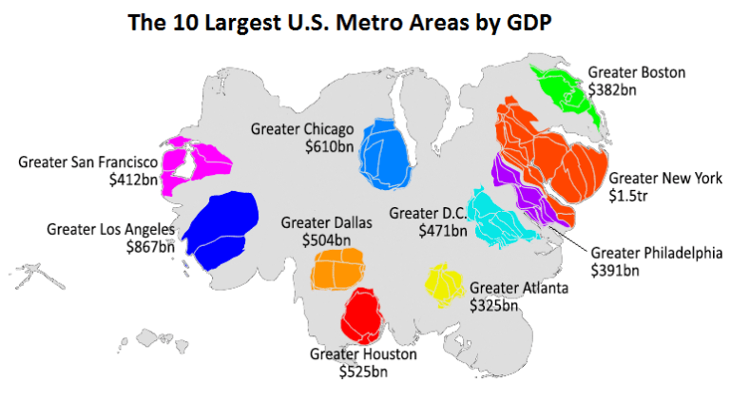
The 10 big ones!

Slide 19
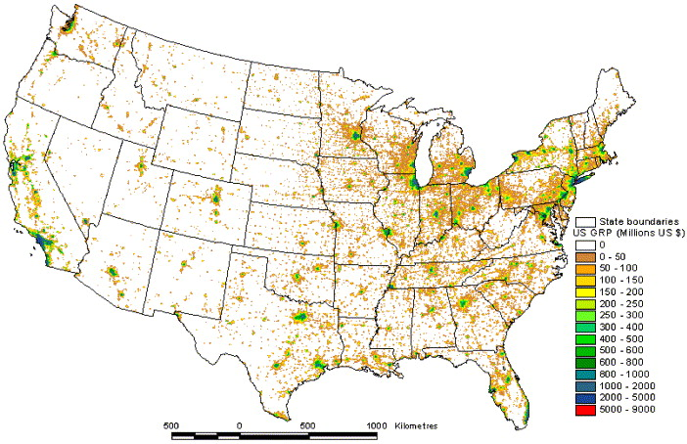
Light with Roads

Slide 20
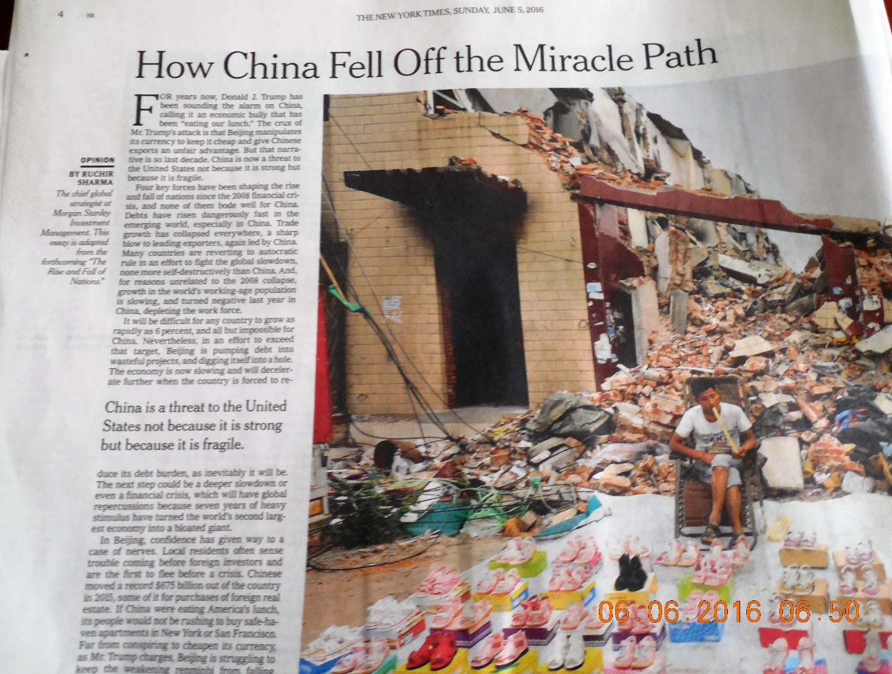
China is a treat not because it is strong, but because it is fragile

Slide 21
CHINA!
One half of our trade deficit is with CHINA
They buy essentially nothing from us...we give them jobs and money
They kept our Google from winning in China—they are keeping our Apple from winning and are trying to start their own Boeing, and they are trying to become self-sufficient in agriculture as well…that is not free trade.
Read: Auto, Dorn and Hansen, “The China Shock: Learning from Labor Market Adjustment to Large Changes in Trade,” NBER Working paper, February 2016. The authors are from MIT, U of Zurich and NBER respectively. Essentially, they show empirically and solidly that ‘free’ trade was not free and that the USA gave away jobs and got nothing in return but deteriorating urban areas across the USA. Free trade theory simply did not work. Trade is essential across individuals and within a country, but across countries the assumptions needed are not there.

Slide 22
Summary
World will have slow GDP in 2017
Cap-rates will begin to rise
Inflation will begin to rise
USA trade deficit too high (4% for 2017)
TOO few good jobs—only top 10% won since 1972—acerbated since 1990s: rule need to change

Slide 23
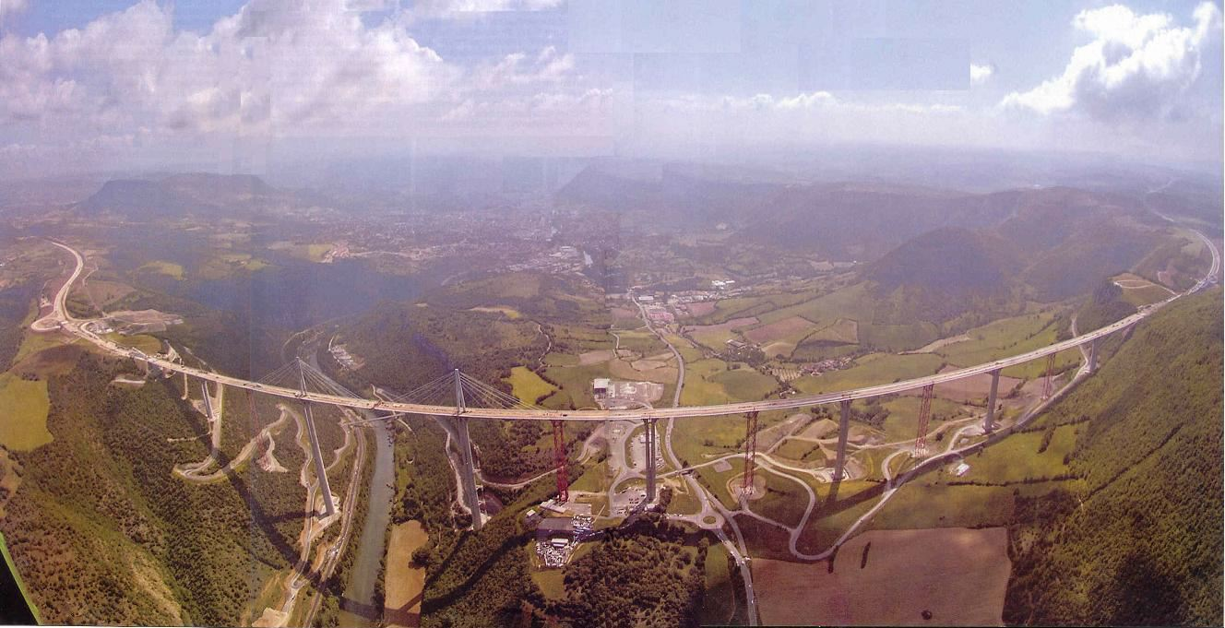
What’s Your View?

