Slide 1

2017 Autumn Seminar
Association of Garda Sergeants and Inspectors

Slide 2

Pay Talks Timeline
President
Antoinette Cunningham

Slide 3
Pay Talks | Timeline and Progress
18th May: Non-affiliated ICTU Groupings Chiefs/Superintendents/GRA/RACO/PNA/PDFORRA/Dental Association
Parity Of Esteem
One overall agreement – no sectoral appendix

Slide 4
Timeline and Progress
22nd May: Chair Oonagh Buckley WRC
Main representatives from each Union/Association – ICTU Negotiation Team, Shay Cody IMPACT, Shiela Nunan INTO, Tom Gerity, Gene Mealy SIPTU

Slide 5
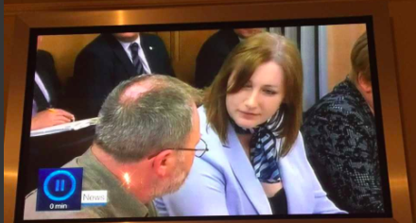
Pay Negotiations

Slide 6
The Pay Talks
Key priority to build on previous agreements, i.e. hours
Details on Public Finances, risks to economy, Brexit and Policy uncertainty in USA

Slide 7
The Pay Talks
External Service delivery
Saturday working and premium payments
Performance management & accountability
Working patterns
Time & Attendance systems
Rostering
Redeployment
Recruitment
Professionalism & Reskilling
Standardisation of salary payment cycles.

Slide 8
The Pay Talks
Time and Attendance, rostering and standardisation of pay cycles
DEPER then Management from each sector and then Union/Association representatives.

Slide 9
The Pay Talks | Wednesday 24th May
10.30am Pension Issues: Peter Brazil DEPER & John Pender DEPER actuary, costings i.e. AGSI assumptions on McMillian report
12noon Time & Attendance Issues: Garda Mgt on development of duty management system, system to incorporate A/L, rest, working times, ensure compliance with WTA, engagement with Associations
2.30pm Additional Hours: Garda Mgt on Patrols, crime detection, crime prevention, Croke park, Aviva, significant cost saving from O/T budget
4pm Recruitment: Garda Mgt on enhanced and improved Garda Reserve, enhance civilianisation, open recruitment, direct entry methods, build on Garda Inspectorate Report

Slide 10
The Pay Talks | Thursday 25th May
Garda Sectoral Meeting: Facilitated by WRC John O’Callaghan, Dept. of Justice
Rosters/Shift Pay: Time and attendance, Redeployement – assigned to Districts not Stations, Hybrid Policing, leave in hours instead of days.

Slide 11
The Pay Talks | Friday 26th May
Working Patterns, Performance Mgt, Open recruitment: Saturday working where it doesn’t exist, conduct examinations on sector by sector basis, normalisation of Saturday as working day, removal of allowance.
Robust performance management systems, full implementation by 2019
Exploring direct recruitment and alternative recruitment methods.

Slide 12
The Pay Talks Monday 29th May-Friday 2nd June
DEPER, FEMPI presentation, resources etc.
Recruitment and retention
Pension issues
O/T and pay divisor
Work/ life balance
Wednesday 31st May - draft text of Agreement

Slide 13
The Pay Talks Tuesday 6th – 3am Thursday 8th June
Final text of agreements
Main negotiations at this point by ICTU
Some sectoral up-dates to Garda Associations

Slide 14
The Pay Talks Tuesday 6th – 3am Thursday 8th June
FEMPI Legislation: Temporary measure now permanent
Additional Superannuation Contribution
Commission on Policing, Kathleen O’Toole
No retrospection on pay
Deferral of payments of increments

Slide 15
Questions & Answers

Slide 16
Public Service Stability Agreement
2018-2020
General Secretary
John Jacob

Slide 17
1. Introduction

Slide 18
1.1. Extension of the Lansdowne Road Agreement
Public Service Stability Agreement (PSSA) is an extension of Lansdowne Road Agreement
Terms contained therein and existing agreements remain, unless altered by this agreement
WRC recommendations of Nov 2016 and supporting documentation continues in force

Slide 19
1.2. Economic and Fiscal Context 2 Supporting ongoing reform and delivering productivity and accountability

Slide 20
2.3. Delivering Greater Productivity
Agree to extension of Lansdowne Road Agreement 2013-2018 until 2020 with the following update:
The Government’s reform agenda including but not limited to “Our Public Service 2020 – Development and innovation framework
And in the Justice Sector the modernisation and renewal programme 2016 -2021, which includes the agreed recommendations of the Garda Inspectorate Report, “Changing Policing in Ireland” and any recommendations agreed by Government that will arise from the Commission on the future of Policing in Ireland;

Slide 21
2.4. Rostering
Commitment to ongoing reviews of rosters
Any changes will be by agreement
Issues arising shall be referred to LRA oversight body
Although not specifically mentioned, Westmanstown Process remains in place in AGSI

Slide 22
2.5. Time and Attendance
An Garda Síochána currently developing Duty & Roster Management System (DRMS) elements impacting members are being discussed at Westmanstown with Associations
No proposals brought forward in relation to Time and Attendance yet – we have a commitment to engagement in this element from Garda management

Slide 23
2.7. Performance and Accountability
Compliance with this Agreement requires that appropriate performance management systems must be fully implemented in those sectors where they do not currently exist by 1 January 2019.
PALF ongoing in AGSI
No change to what is currently agreed

Slide 24
2.9. Standardisation of Payroll Arrangements
No change currently
Parties to this proposal agree that pay roll operations can be modified
subject to consultation
no monetary loss to the employee
where a business case can be established
Will require engagement and consultation with Associations

Slide 25
2.11. Recruitment
The Agreement also commit the parties “to discuss” more open recruitment “where this is appropriate to meet particular organisational needs.”
Garda Inspectorate already examining entry routes to AGS which we have made a submission

Slide 26
2.12. Working Hours
Haddington Road Hours continue to be a feature of this agreement
Current practice as agreed with Garda Management in HQ 22/17 January 2017 remain in place for the duration of the agreement

Slide 27
2.13. Working Patterns
There is no change to the current working patterns in AGSI
Changes to working patterns can only take place under the Westmanstown Process
Must comply with WTA

Slide 28
3. Recruitment and Recreation
Not a particular problem for AGSI currently
The agreement allows for parties to make submissions in this area as necessary

Slide 29
4. New Entrants
An examination of salary scales issues in respect of post 1/1/11 will be undertaken within 12 months of commencement of this agreement
Discussion on implementation will take place thereafter

Slide 30
5. Pay

Slide 31
5.1. Unwinding of FEMPI
2018
1 January 2018 annualised salaries to increase by 1%;
1 October 2018 annualised salaries to increase by 1%.
2019
1 January 2019 annualised salaries up to €30,000 to increase by 1%*;
1 September annualised salaries to increase by 1.75%.
2020
1 January 2020 annualised salaries up to €32,000 to increase by 0.5%*;
1 October 2020 annualised salaries to increase by 2%.
* These pay increases do not apply to Gardaí or other civil servants earning over this amount. The gross value of the pay increase for our members is 5.75% over 2 years and 10 months

Slide 32
5.2. Outstanding Adjudications
These matters are not in adjudication but are still ongoing with the WRC;
39 Hour working
Pay divisor
Buy-back of service

Slide 33
6. Pensions

Slide 34
6.1. Additional Superannuation Contribution
Explain: PRD converted to ASC
ASC, effective from January 2019 and not applicable to non-pensionable earnings – i.e. overtime or non-pensionable allowances
Public Servants who are Members of pre-2013 Pension Schemes with Fast Accrual Terms (Unchanged)
Band | Rate
Up to €28,750 | Exempt
€28,750 - €60,000 | 10%
€60,000 plus | 10.5%

Slide 35
6.2. Public Service Pensions in Payment
No change to current pension benefits
Pre-2013 pensions will continue to be linked to pay for the duration of this agreement

Slide 36
6.4. Mandatory Retirement Age
Further policy in this area will be considered by Government
If we are signed up we will be consulted in any proposals

Slide 37
7. Resolving Disagreements
All agreements have a process for resolving disagreements
This agreement is the same but it puts time lines on the process

Slide 38
8. Ensuring Compliance with this Agreement

Slide 39
Maintenance of Industrial Peace
A recurring clause in all agreements; All forms of industrial action are precluded in respect of any matters covered in this Agreement
LRA Oversight body remains in place

Slide 40
8.3. No Cost Increasing Claims
Standard clause now in these agreements
No scope to bring new claims for allowances or pay increases during the Agreement
8.4. Review of Agreement

Slide 41
2.6. Professionalisation
Sections not impacting AGSI
2.8. Public Service Mobility
2.10. Apprenticeship and Traineeship in the Public Sector
2.15. Agency Staffing
2.14. Work-life balance

Slide 42

Closing Remarks

Slide 43
Questions & Answers

Slide 44
Interdepartmental Working Group
on Industrial Relations

Slide 45
Setting the Scene
Set up early 2017
First stage recommendations September 2017
Next stage expected by year end
AGSI denied access to membership of the Group
Submissions only
ICTU submissions not published but integrated
Denial of EuroCOP decisions
Major challenge for AGSI for 2018/2019

Slide 46
Regarding Access to the WRC and Labour Court
Garda Associations have a legitimate aspiration to have access to mechanisms for dealing with all matters relating to the terms and conditions of their employment
Government Decision, the Garda Associations should be provided with access to the WRC and the Labour Court
The Working Group concurs with the views of the Garda Associations that providing access to the IR machinery of the State is essential

Slide 47
Access to WRC & Labour Court
State institutions should only be accessed when parties have exhausted the employee engagement/dispute resolution mechanisms available to them
Internal dispute resolution mechanism; Garda C&A scheme would be appropriate amended as required

Slide 48
Regarding Trade Union Status
Question;
In order to engage with the WRC and the Labour Court, the Garda Associations should be reconstituted as Trade Unions?
A significant aspect of Trade Union status relates to the protections in legislation with regard to legitimate industrial action.

Slide 49
Affiliation to ICTU
Gives rise to obligations and responsibilities to Congress and the broader trade union movement.
Garda trade union - Risks
might become embroiled in industrial action commenced by a different staff association in different sectors as part of a united ICTU campaign,
Incitement by members of ICTU or other affiliated trade unions to reduce or withdraw Garda services in support of a sectoral dispute.
ICTU has a strong political perspective, and can engage in political campaigns.
This activism might be at odds with the non-political role of An Garda Síochána.

Slide 50
ICTU’s Concerns
Significant concerns about the ability of the Garda Associations to engage fully with the State’s industrial relations processes unless they transition to becoming Trade Unions within the legislation

Slide 51
Conclusion & Recommendations
The unique requirements of An Garda Síochána would not be served by reconstituting the Garda Associations as Trade Unions
Obligation to ensure that the members of An Garda Síochána are not disadvantaged as a result
Acknowledges that this is an area of complexity and sensitivity – different views of Associations and ICTU

Slide 52
Conclusion & Recommendations, contd.
That the Industrial Relations Act 1990 be amended;
The Garda Associations maintain their current status as statutory bodies established - do not transition to becoming trade unions;
The Garda Síochána Association Regulations be amended to include the rules of governance that apply to Trade Unions and govern their interactions with the Workplace Relations Commission and Labour Court.

Slide 53
Regarding the Taking of Industrial Action
A fundamental issues for consideration was whether members of An Garda Síochána should take industrial action up to and including strike
Working Group considered the responsibility that falls on the State and An Garda Síochána to ensure the uninterrupted delivery of the essential services associated with policing and national security

Slide 54
Conclusion & Recommendations
Members of An Garda Síochána should continue to be constrained from withdrawing their labour in any strike action likely to impact on policing, the security of the State or the maintenance of public authority;
Every effort should be made to identify and agree processes that will eliminate recourse to ‘lower level’ industrial action and/or reduce the impact of such industrial action on the most essential services provided by An Garda Síochána.
This should form part of the discussions in relation to the internal dispute resolution process

Slide 55
Regarding Mechanisms for Pay Determination
Garda Associations should be enabled to make representations with regard to pay and related conditions in a manner which is no less advantageous than the facilities available to other public servants.
Make representations regarding overall pay issues to the Pay Commission, as appropriate and on request from the Commission;
Engage with their employer(s) through internal mechanisms regarding matters pertaining to pay and conditions of service;
Engage with the main industrial relations machinery of the State – the WRC and Labour Court – where issues cannot be resolved by other means.

Slide 56
Conclusions & Recommendations
Associations should have access to;
The Pay Commission when appropriate,
The WRC and the Labour Court as required,
A robust internal dispute resolution measures – (to be made available to the Garda Associations);
The Garda Associations should, in all cases, be enabled to make representations with regard to pay and related conditions in a manner which is no less advantageous than the facilities available to other public servants;
Should not have access to an independent pay review body

Slide 57
Questions & Answers

Slide 58
Hybrid Policing Model

Slide 59


Slide 60
Background & Drivers for Change
Fit for purpose policing PWC Service Delivery model report 2012
Garda Inspectorate report Changing Policing in Ireland 2015
MRP Document 2016 – 2021
Policing Plan 2017

Slide 61
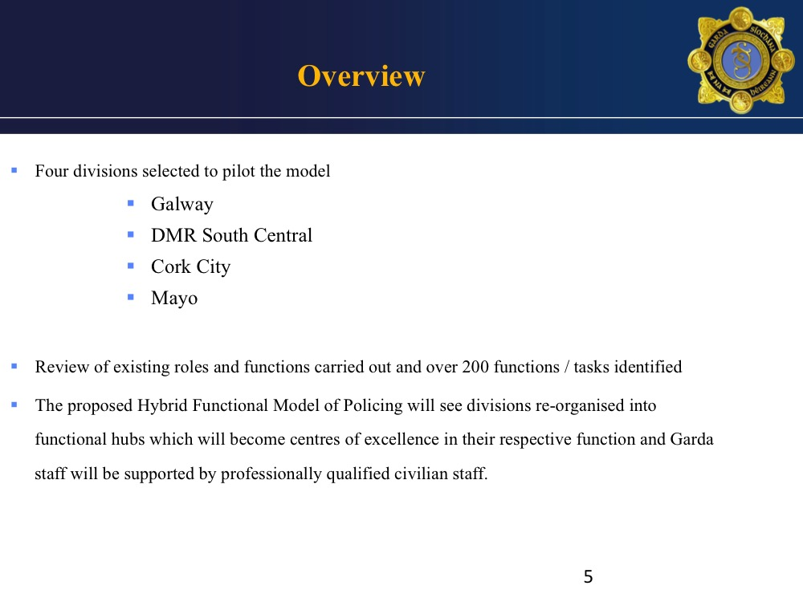

Slide 62
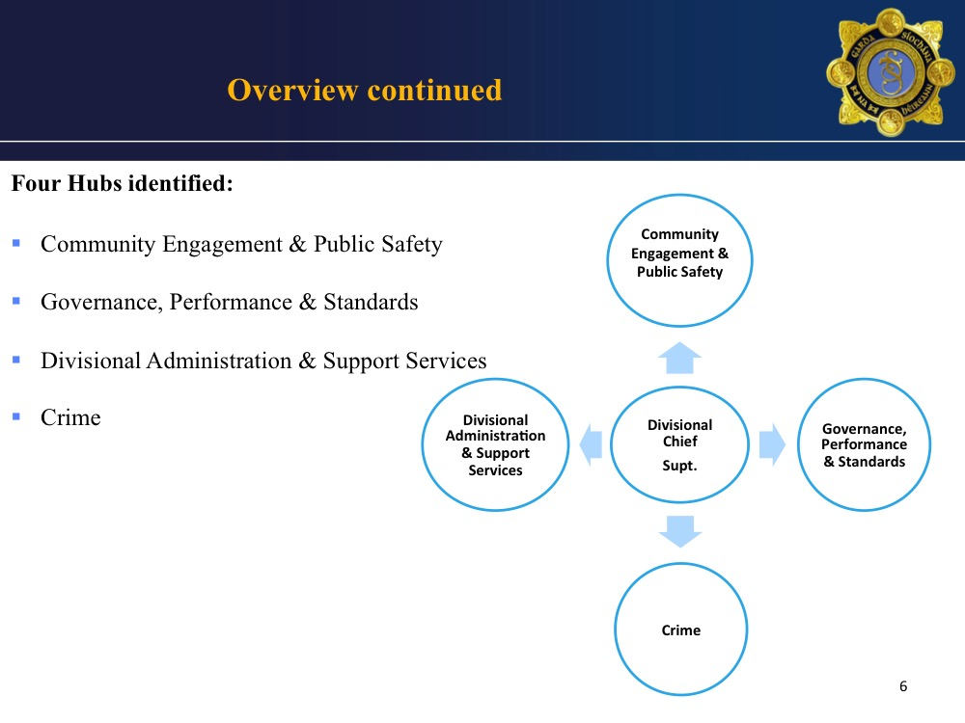

Slide 63
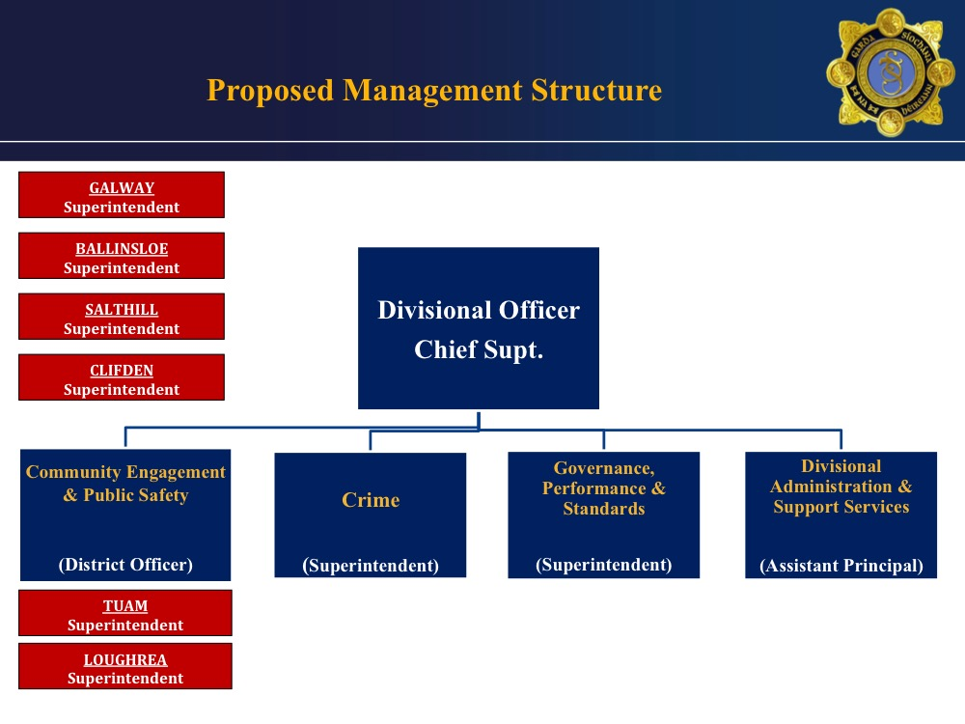

District 1
District 2
District 3
District 4

Slide 64
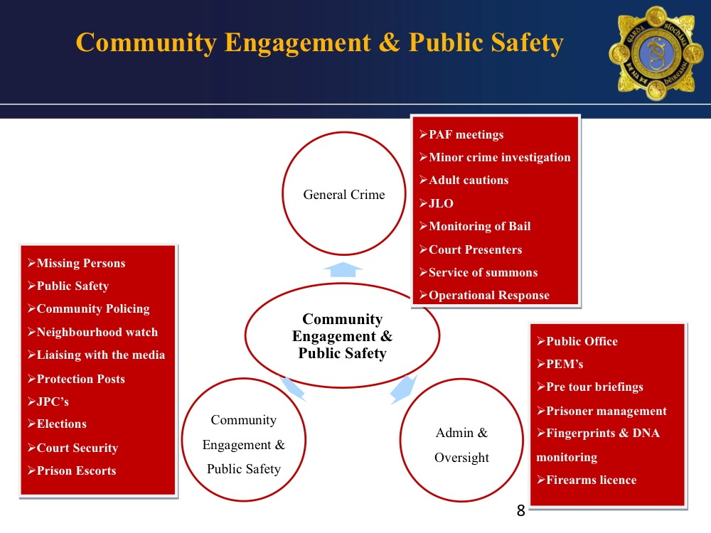

Slide 65
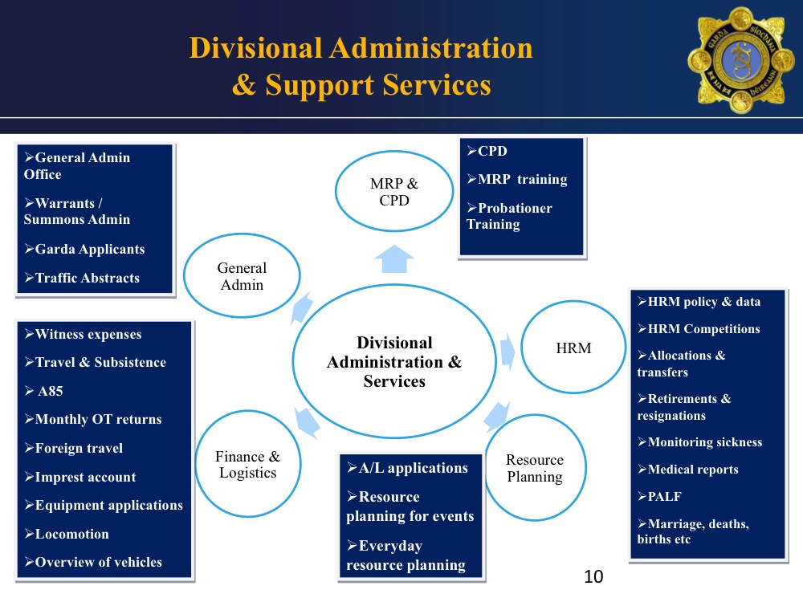

Slide 66
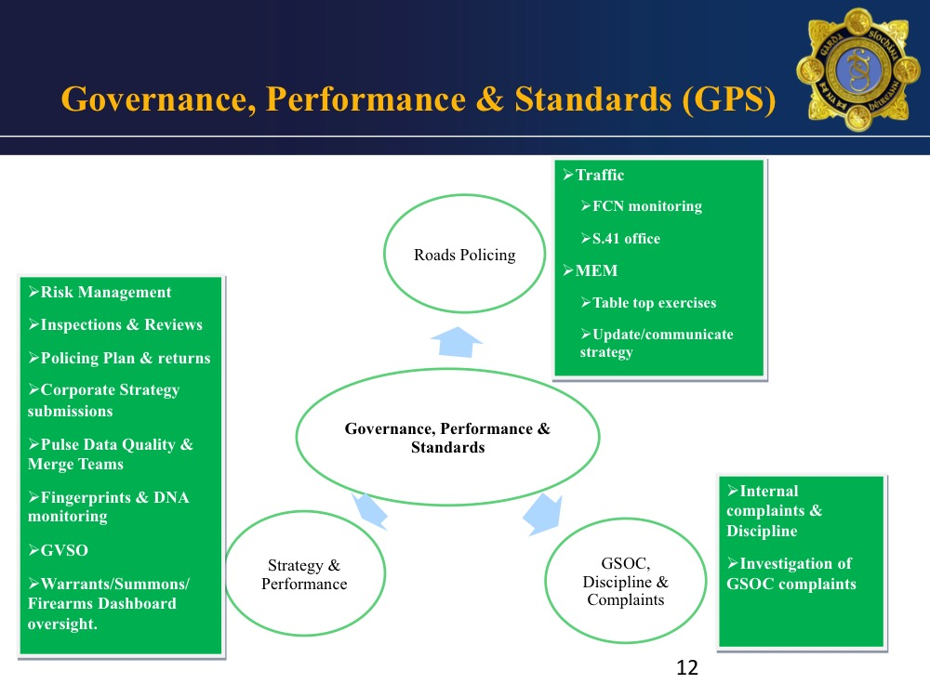

Slide 67
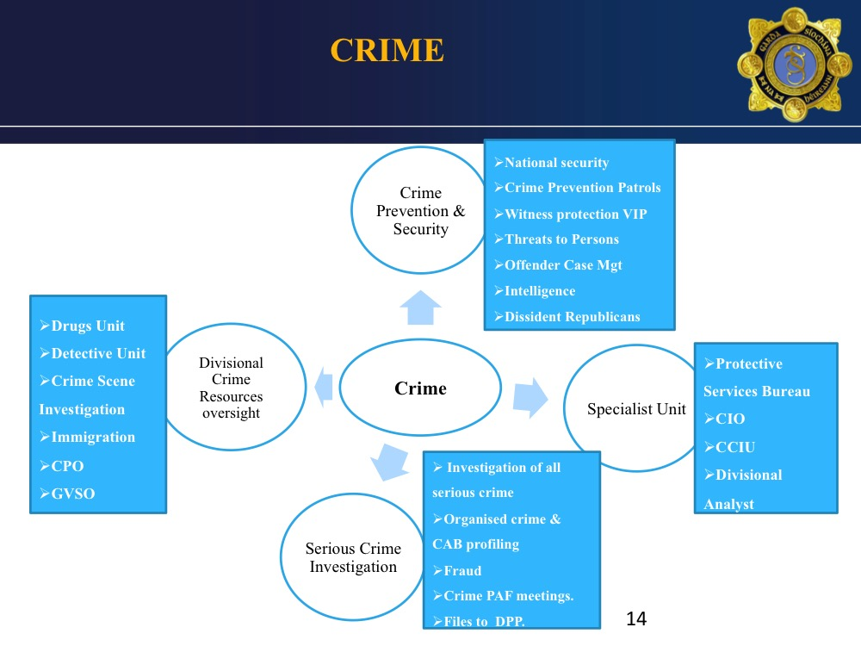

Slide 68
Questions & Answers

Slide 69
AGSI Rosters
Cormac Moylan

Slide 70
Current Status
Westmanstown - meeting 25/8/2017
Presentation on proposed Roster and Duty Management System
Contract Awarded – Accenture / Crown Computing – 11 other Police forces in U.K.
System Compliant with ETWD and WTA

Slide 71
Roster and Duty Management System (RDMS)
Forward Planning Tool
Manage Annual Leave, Absences, Abstractions
Skills Database
Records Time and Attendance
Capable of Calculating Overtime and Allowance entitlements
Compensatory Rest enabled

Slide 72
RDMS Pilot
Q.4 2017 – Configuration of system
Proposed to start pilot in March 2018
Possibly 4 Divisions
Centrally managed

Slide 73
Executive Position
Continue to engage in the process
Changes not agreed to LRA Oversight Body

Slide 74
Questions & Answers

Slide 75
Service Recognition / Outstanding Matters
WRC
John Jacob

