Slide 1
Construction 101
Start to Finish
This presentation has been developed to provide an overview of the construction process and not to discuss specific coverage issues. Statements in this presentation as to policies and coverages and other content provide general information only and we provide no warranty as to their accuracy. Any discussion of exposures herein are solely the opinion of the individual presenter. The discussion of coverage and what may be covered under a policy depends upon specific facts and circumstances. New Day cannot and does not offer an opinion on what may or may not be covered under an individual insured’s policy. Nothing in this presentation is intended to suggest if a claim may or may not be covered under an individual policy. Please consult with your licensed insurance broker or legal counsel as to how insurance coverages pertain to your individual situation.

Slide 2
Types of Project Delivery Start to Finish – Design Bid Build
Initial Phases
  Conceptual - Owner
  Site exploration and selection
    Search
    Due diligence / Acquisition
    Zoning / Public Hearings
    Traffic Studies
    Permitting
    Financing
    Design – Architect and Design team

Slide 3
Types of Project Delivery Start to Finish – Design Bid Build
Design
  Architectural
  Geotechnical Investigation
  Environmental Impact Investigation
  Civil Site Design
  Foundation / Geotechnical Design
  Structural Design
  Electrical Design
  Mechanical Design
    Plumbing
    Sewer
    HVAC
  Fire Prevention

Slide 4
Types of Project Delivery Start to Finish – Design Bid Build
    Advertise and Award
      GC
      CM AR
      CM Agency

Slide 5
Construction Management – All GCs!!!
Construction Management – Even when not contracted as CM
  Hire and oversee subcontractors?
  Work on DB and use BIM?
  Manage a budget and schedule?
  Make field decisions / changes to plans and specs?
  Do value engineering?

Slide 6
Contractor Tasks
Construction means, methods, techniques, sequences
  Day to day activities
  Incidental design (field changes)
  Rigging
  Shoring
  Scaffolding
  Construction Crane
  Temporary Elevators

Slide 7
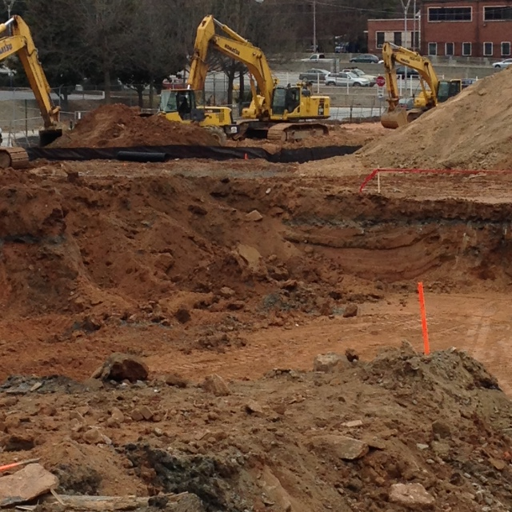
Erosion control, grading and foundation prep

Slide 8
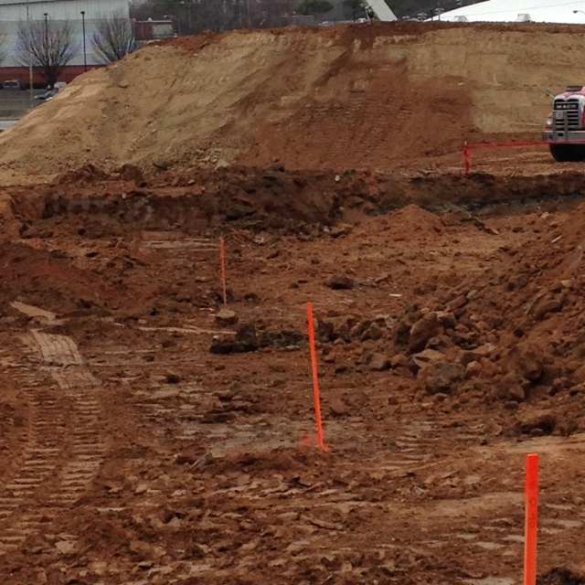
Surveyor sets elevations for foundations, footprint and alignment

Slide 9
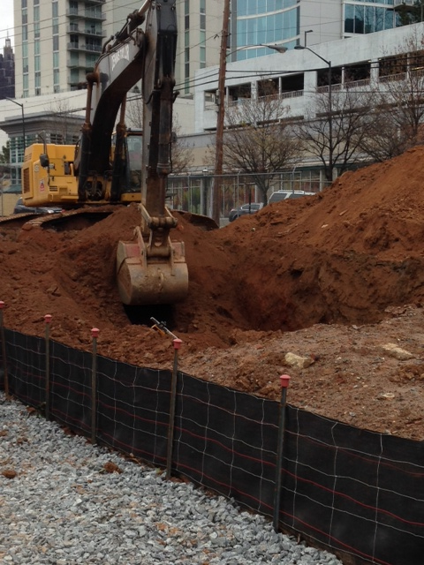
Excavation to design elevations

Slide 10
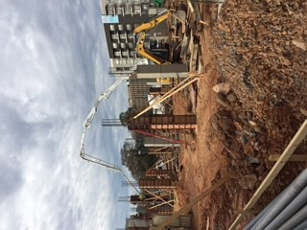
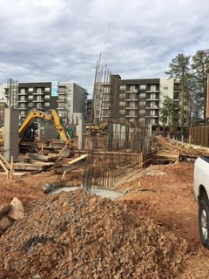
Caisson footings and load bearing columns

Slide 11
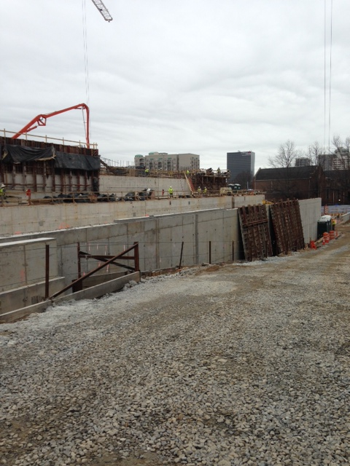
Temporary retaining wall, concrete forms and
Trenching

Slide 12
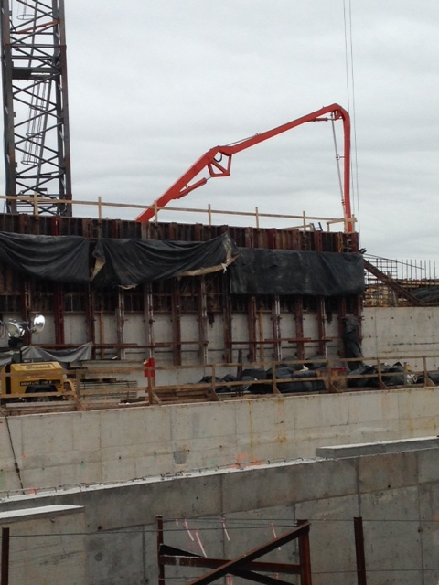
Concrete forms, concrete pump, and staging construction phases

Slide 13
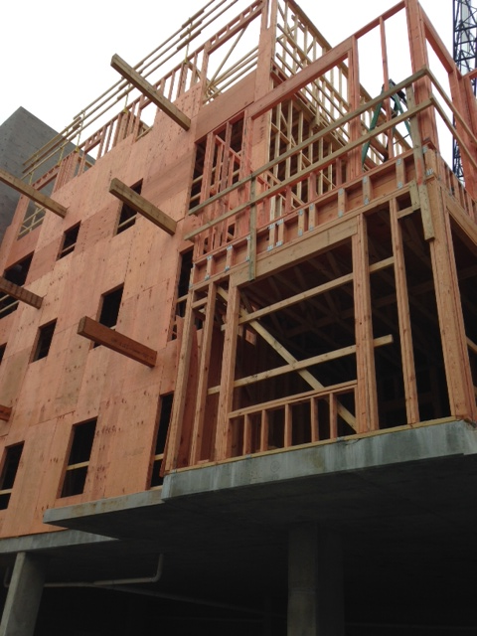
Wood frame construction over cast in place concrete parking deck

Slide 14
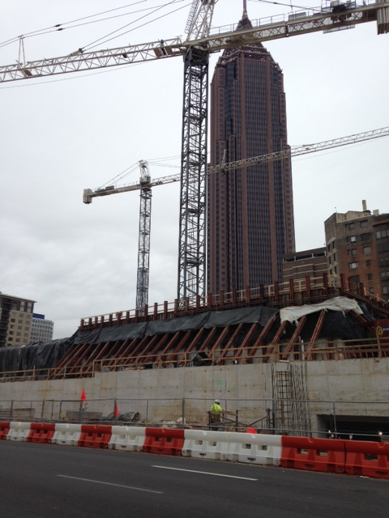
Construction cranes, temporary shoring and traffic control

Slide 15
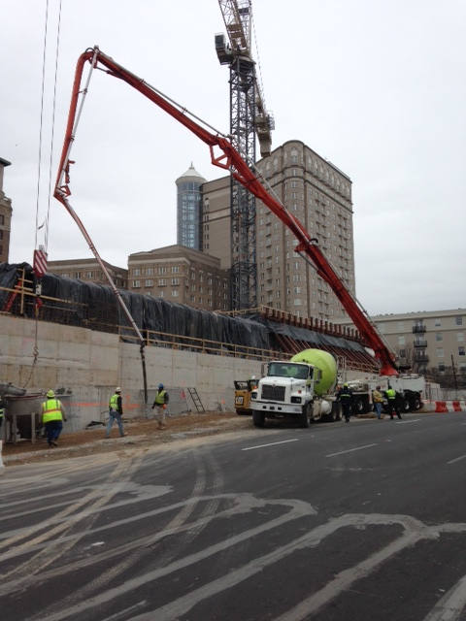
Construction cranes, staged concrete pours

Slide 16
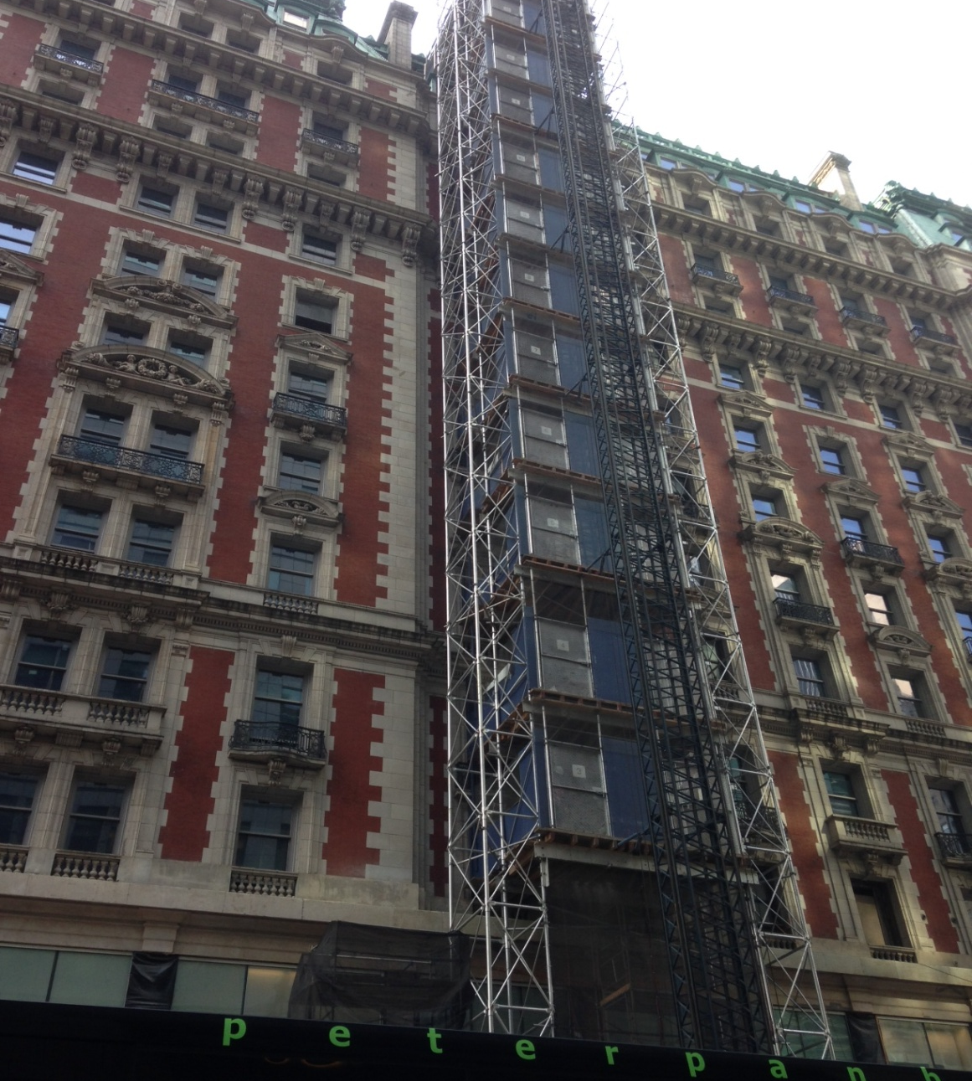
CMM – Temporary construction elevator

Slide 17
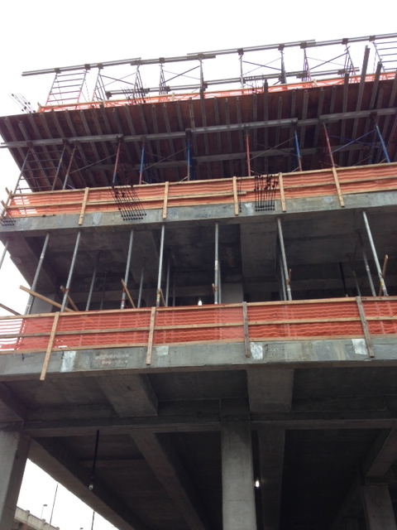
Post tensioned concrete, scaffolding and shoring

Slide 18
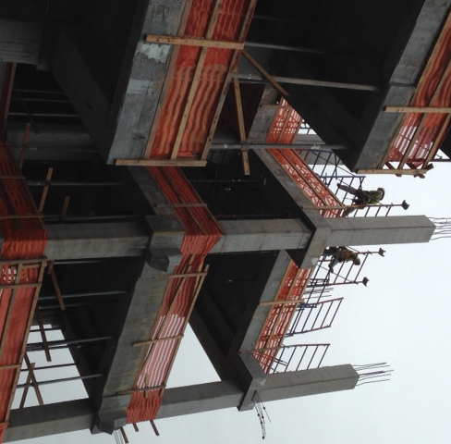
Ironworkers tying rebar, construction joints, temporary safety fencing and shoring

Slide 19
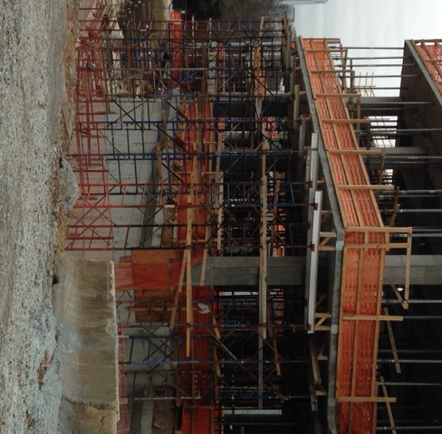
Scaffolding and shoring

Slide 20
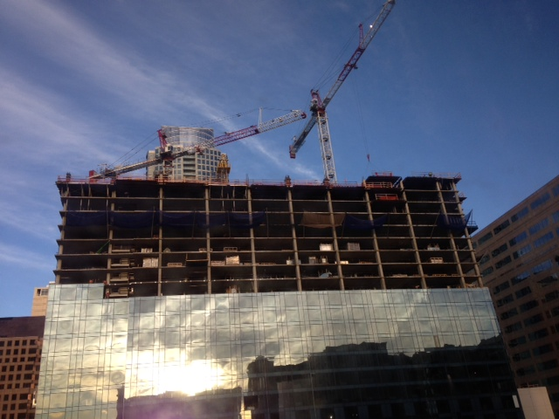
Fast Tracking - Envelope construction as higher stories continue under construction

Slide 21
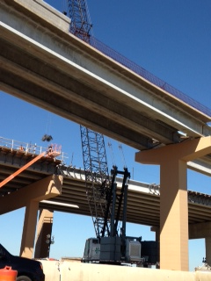
Pre-stressed beams on new highway interchange

Slide 22
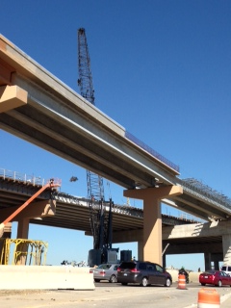
Highway bridge setting beams, rebar for composite deck and NJ barrier walls

Slide 23
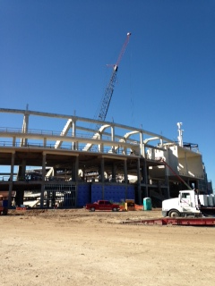
Number One cause of Contractors Professional Liability claims for project delay and economic damages

Slide 24
QUESTIONS?
  Mitch Cohen, PE
  Vice President
  New Day Underwriting Managers LLC
  (Alpharetta, GA office)
  2465 Kuser Rd., Suite 202
  Hamilton, NJ 08690
  609 298 3516 ext 107
  404-452-8438 - Mobile
  Mitch.cohen @newdayunderwriting.com
This presentation has been developed to provide an overview of the construction process and not to discuss specific coverage issues. Statements in this presentation as to policies and coverages and other content provide general information only and we provide no warranty as to their accuracy. Any discussion of exposures herein are solely the opinion of the individual presenter. The discussion of coverage and what may be covered under a policy depends upon specific facts and circumstances. New Day cannot and does not offer an opinion on what may or may not be covered under an individual insured’s policy. Nothing in this presentation is intended to suggest if a claim may or may not be covered under an individual policy. Please consult with your licensed insurance broker or legal counsel as to how insurance coverages pertain to your individual situation.

